Slide 1
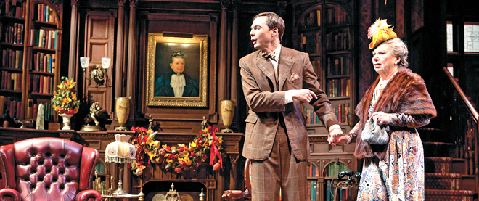
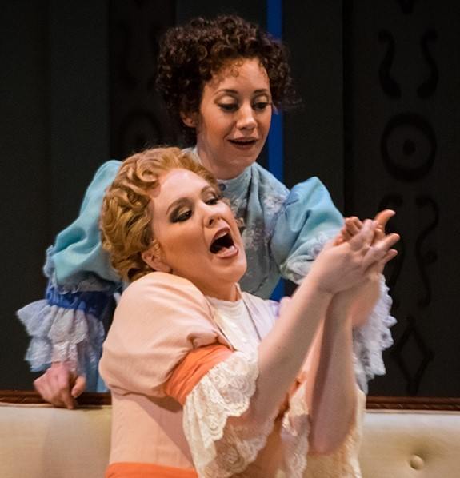
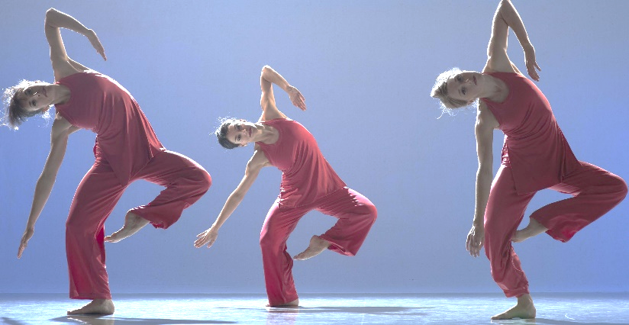
Lessons Learned from the Performing Arts to Make Your Presentations Shine
Lisa Borok, CIT, CHI, CIG
Notes:
Intro Lisa (and acknowledge Elise as co-author)
Like these people, we use our bodies and voices extensively in our work.
Crash course! Give you a taste of what’s possible and how you might use this info/techniques and giveyou ideas of where to go for more.

Slide 2
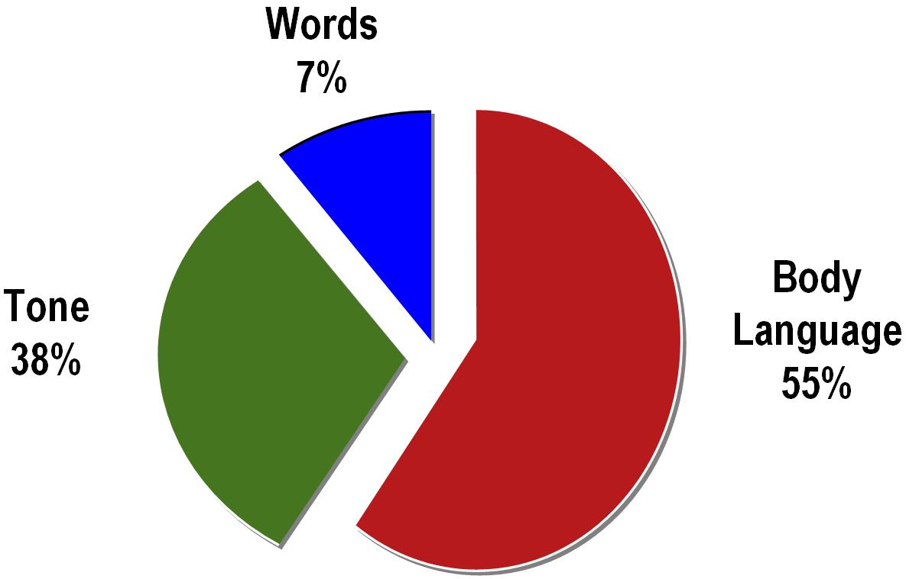
Dr. Mehrabian’s Pie
Notes:
We’ve all seen this or something similar. Which means: your words are important and so are your sounds and movements. Non-verbal is a reality of personal interpretation and an important (and large) part of how you and your message are received.
Dr. Albert Mehrabian, UCLA prof. of psych. Studies beginning in 1970s on elements of communication.

Slide 3
Like Artists, We Use Our “Instruments” Too
Daily, if you’re on the front line, or training those who are
Periodically or daily, for presenting to teams, managers, agencies, foundations, stakeholders, boards & media

Slide 4
Unlike Artists, Interpreters Have:
Little training in using our voices & bodies for communication
No daily practice to keep the body parts we rely on in good shape
Few guidelines for optimizing our performances
Vague ideas of how to help ourselves & others with speech & stance issues
Notes:
Ask: Has anyone had theater, singing, instrument, dance training?
Issues: irritating habits or damaged voices; can tell “something “ needs fixing but not sure how to diagnose and counter.

Slide 5
Workshop Objectives
Attendees will be able to:
Demonstrate two vocal & two physical warm up techniques
Describe one method each to enhance vocal production & nonverbal cues
Model one physical technique to take focus & project authority

Slide 6
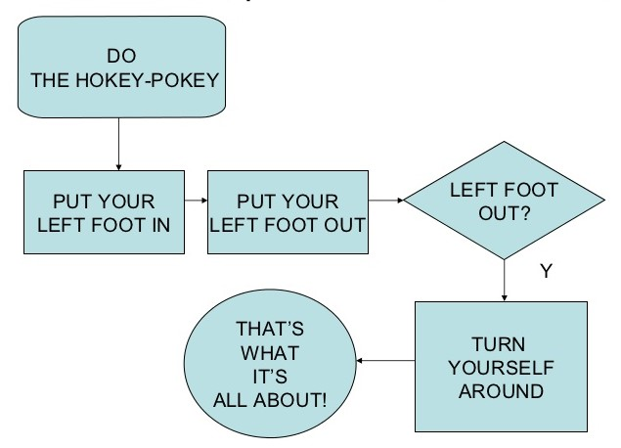
Presenting is a Workout!
So, Let’s Warm Up!
Notes:
Increases oxygen & blood flow
Loosens muscles
Awareness of tension & imbalances
Prepares specific muscles for moving & speaking (the work ahead)

Slide 7
Whole Body!
Deep breath then, hug yerself!
Rag doll (head last up)
Shoulders (shrugs, rotations)
Neck (sides, back)
Ribs, torso (side stretch)
Legs, feet (shake out)
Face, Mouth (lion & prune)
Check for tension & imbalance
Notes:
Speaking (and moving) uses the whole body!
Breath is quiet!
Tension restricts air (capacity and sound)

Slide 8
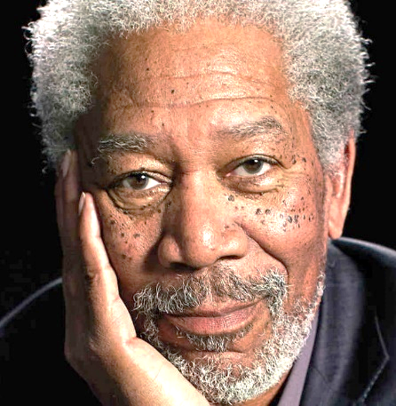
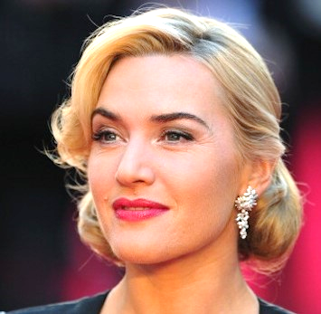

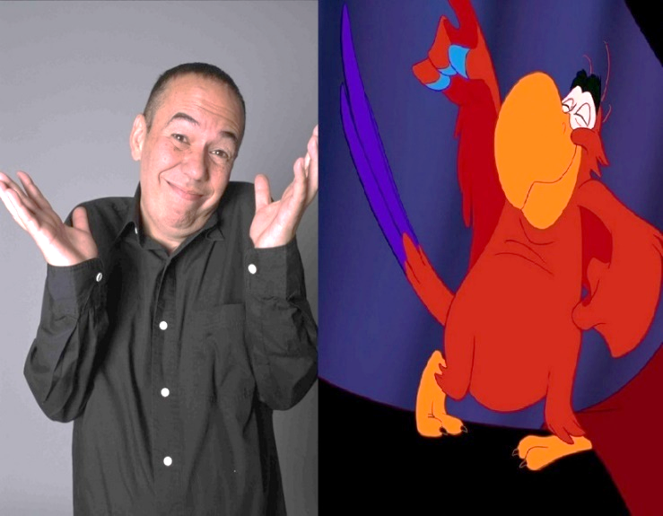
What Voices Do You Love?
Or Not…
Notes:
Qualities of voices: Pitch, reverb or resonance, nasal, breathiness, clarity, the way their vowels and consents sound (articulation), the rhythm/cadence.
Wiliam… Shat Ner.
Morgan Freeman, Kate Winslet, Kim Kardashian, Gilbert Godfried (AKA “Iago” “Aflac duck”)

Slide 9
Where Voice Comes From
Breath (power, volume, stability)
  in lower torso
Vibration (tone, pitch, texture)
  in vocal cords
Resonance (warmth, nasality, clarity)
  in mouth & face
Notes:
Torso: hands on ribs/back
Vocal: adams apple
Res: feel face

Slide 10
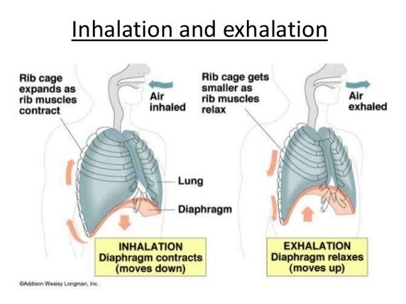
Your Voice Comes From: Breath
Notes:
Describe and feel breathing process.
Diaphragm across whole torso. DOES NOT STICK OUT; we have little direct control
Inhale: diaphragm pushes down to allow lungs to expand. Ribs, belly expand and support.
Exhale: the belly and ribs collapse, diaphragm goes back up
Try holding between in and out to feel those muscles at work. Or hug again. Or lie on floor

Slide 11

BREATH POWERS YOUR VOICE!!
Notes:
Why are we dealing with tummies and backs when talking about voices?
Big vs. small muscles; using the correct ones for the job. Can’t do much else if your not breathing right.
If you remember nothing else form this talk, we want you to take home breathing awareness! #1 Improvement to most voices! SUPPORT! Will help a small voice carry better, will make your words sound more supported and therefore more powerful. Will help keep you from overusing the little muscles in your throat instead of the big muscles in your torso.
Singers and actors work on this their whole lives!

Slide 12
Breath warm-ups
On support
  upper body relaxed
  firm, not locked
S & Z on exhale
  extend duration
Exhale & say: This is me talking to you!
  inhale, then say it again
Breathe in the space
Notes:
Always “on support” when speaking. HANDS on RIBS
Breathe more often, if you find yourself gasping or pushing, collapsing.
Extend your capacity and/or firm up your breath support by doing extensions.
Speaking with little air sounds and feels bad.
Breathing in the space also helps to speak to the whole room, take focus.
Great for stage fright, too!

Slide 13
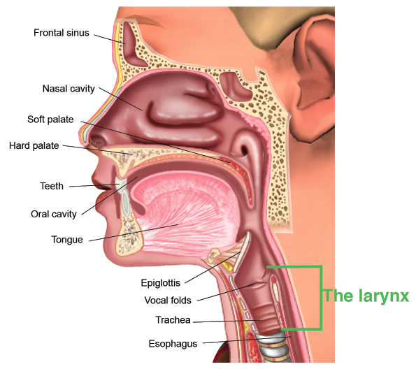
Your Voice Comes From: Vibration
Notes:
Hands on throat: Two tubes (air and food) covered by epiglottis (swallow to feel it in action) .
Feel trachea (hard part).
Tense your neck, jaw: feel what happened?

Slide 14
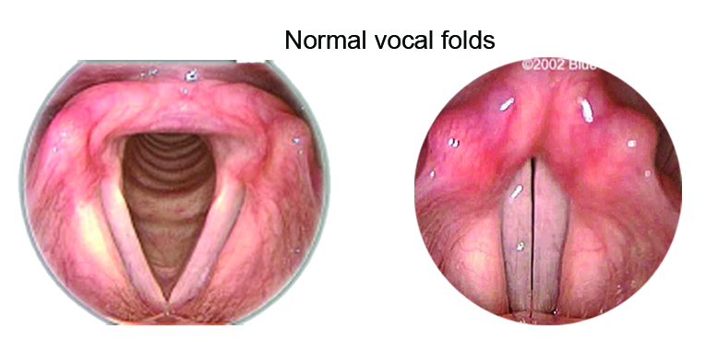
Vocal Cords (Folds)
Notes:
Place index fingers next to each other
Slip a camera down your throat, you’d see this: two little folds opening and closing over your air pipe. As breath moves between these, they vibrate at a regular frequency and cause sound.
TINY muscles move them sideways and back and forth to make pitch. Like a balloon mouth. Really small! Can be injured (2 workers comp cases).
Phlegm, post nasal drip, irritations can affect (Peppermint Patty from crap on my chords, slowing them down)
The natural vibration in singing allows for different notes (as long as they are supported by breath!) “warble” or vibrato. Different voices have different frequencies and differing cultures place value or some of these.
When less air is passing through, the vibration gets less stable and can be more hit and miss. Lower air pressure is also where we can make creaky or “Vocal fry”
Cough, don’t clear.

Slide 15
Vocal Cord Warm Ups
Light humming
Sirens
Sing or recite across your range
Cough, don’t clear!
Vocal fry
Notes:
Prepping vocal folds/chords/voice box for speaking can make a big difference at the beginning of your speaking day AND can help with fatigue at the end of the day.
Removes schmootz, warming teeny tinies too!
Jury is out on vocal fry: some say it’s harmless and that it’s a passing meme, usually of younger women trying to sound more adult and have greater gravitats. Some voice specialists say it’s the equivalent of dragging sandpaper across a skinned knee. I don’t particularly like the sound in excess, in men or women. More air, less creak. Too much air, Marilyn Monroe
Like any vocal habit, self-awareness and knowing your audiences are key.

Slide 16
Your Voice Comes From: Resonance
Notes:
Note where sinuses connect to throat (post nasal drip).
Feel hard and soft palates with tongue (soft flexes, makes space)
Air can go up into nose or down to mouth: affects the “ring” of your voice AND contributes to volume!
Look how big the tongue is! (tension and position of). Part of why jaw wobble is sign of tension!

Slide 17
Resonator Warm Ups
Tapping while humming
Hum to the floor, then out to the room
Pinch nose (on ahhh & ngggg)
  check for nasality
Open throat, lift soft palate
  almost-yawn
Tongue
  behind teeth
Notes:
Ideally, want the soft palate raised, tongue out of the back of the throat, most air coming through mouth
Pinch nose is good for diagnosing nasal voice and also for training out of it.
If too much is in “the mask” then less is getting to listeners
If tongue is back in throat, blocks sound (can also garble words)
Harsher sound if palate is dropped.
Singers can’t get to high note, if soft palate is blocked.

Slide 18
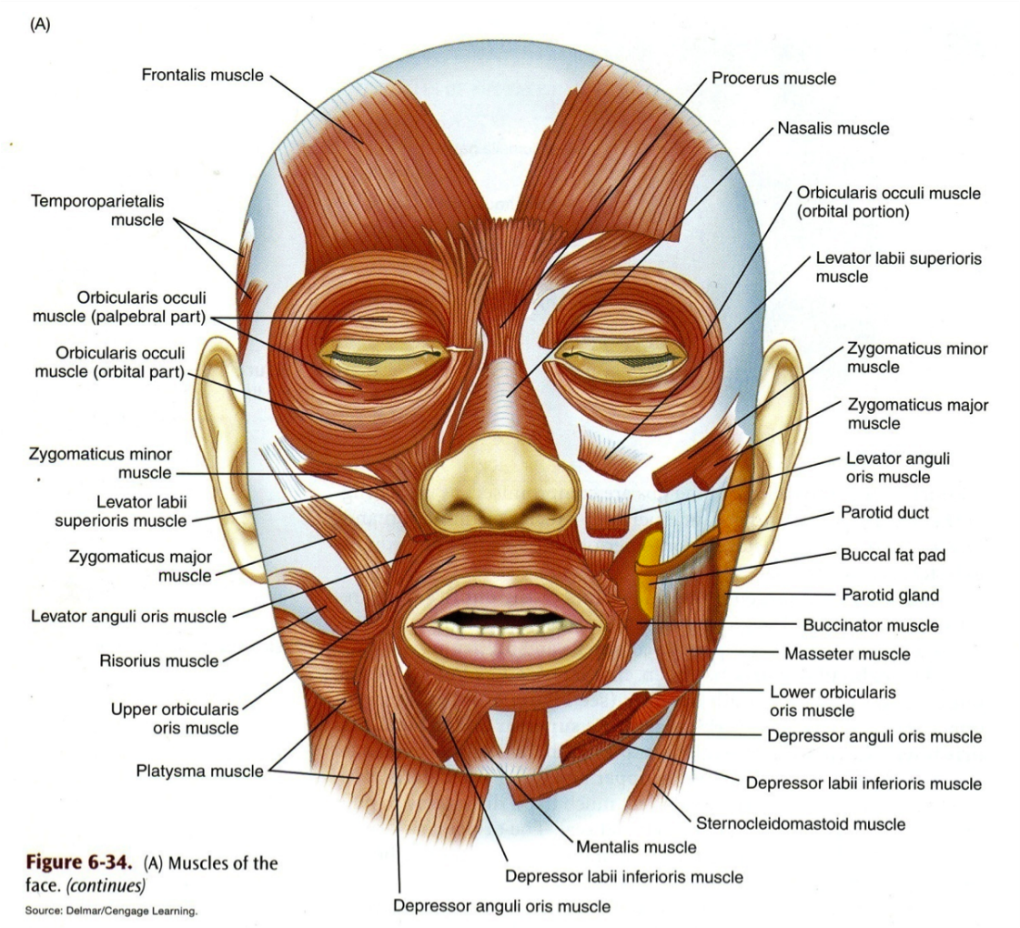
Your Voice Comes From: Diction
Notes:
Bazillions of muscles! Shape words, give emotional cues. (demo: slack talk, animated talk)
Bigger ones around jaw.
Nose and eyes also connected with cheeks and mouth, so they count, too.

Slide 19
Mouth, Face & Tongue Warm Ups
Chew
Brush teeth with tongue
Buzz lips loosely, roll “R”
Tongue twisters (more in handout)
  Lemon liniment
  Unique New York
Notes:
Try to observe which muscles are involved. Top lip, tip and sides of tongue, cheeks, JAW
Diction and air are your best friends, especially if you have a soft voice.
MANY issues can be cleared up with better attention to consonants. Also helpful if your first language is Spanish (or other languages that have softer consonants)

Slide 20
Put Your Best Voice Forward
Warm up every day!
  even 1 minute helps
Breathe before & throughout speaking
Enunciate words
Watch your pitch
  May need to lower slightly
Place voice for the space (talk to hand)
Practice: Read aloud (Dr. Seuss!)
  vary volume, resonance, pronunciation, inflection & speed
Notes:
Also to help someone else sound better!
Slower, clearer, more articulated, pitch works WITH volume (or instead of it)
Talk to the hand: Placing for 6”, 12-24”, >2 feet, outside the room (too far) : allows you to connect to audience. Breath in the whole space you’ll be speaking to. Helps direct the sounds there as well.
If you have to place beyond about 5-10 feet (or about 3-4 rows of standing people) on a regular and sustained basis, you should be using a microphone.

Slide 21
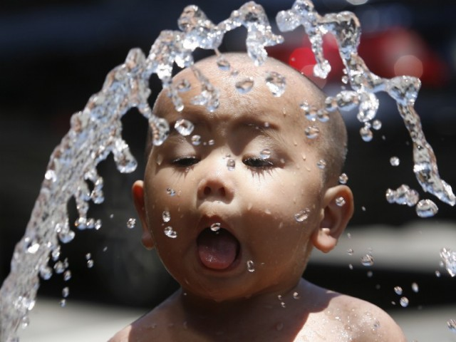
Vocal Health 1
HYDRATION, HYDRATION, HYDRATION!
Notes:
After breath, water is your best friend. Takes 20-60 min to get to your vocal tissues!
Experiment: drink extra two glasses of water per day for a week. Filtered may work better (CL can be drying)

Slide 22
Vocal Health 2
Avoid alcohol, smoking, menthols
Watch loudness & pitch in noisy places
Get voice breaks, more sleep
Gentle cough, don’t clear
Control reflux, allergies & asthma
Sweet & fruity, licorice root, slippery elm
Wash hands and face (protect health)
Notes:
Football game (silently cheer on Sunday)
Menthol strips good mucus
One of the workers comp cases complicated by reflux

Slide 23

Using Space, Using Your Body
Learn to use space effectively to better convey your message

Slide 24

Where to Stand
What do you want the audience to see?
Face the audience!
Don’t block the view
Theater in the round
Pivot turn
Use the landscape
Notes:
Practice pivot turn
Describe toes moving

Slide 25
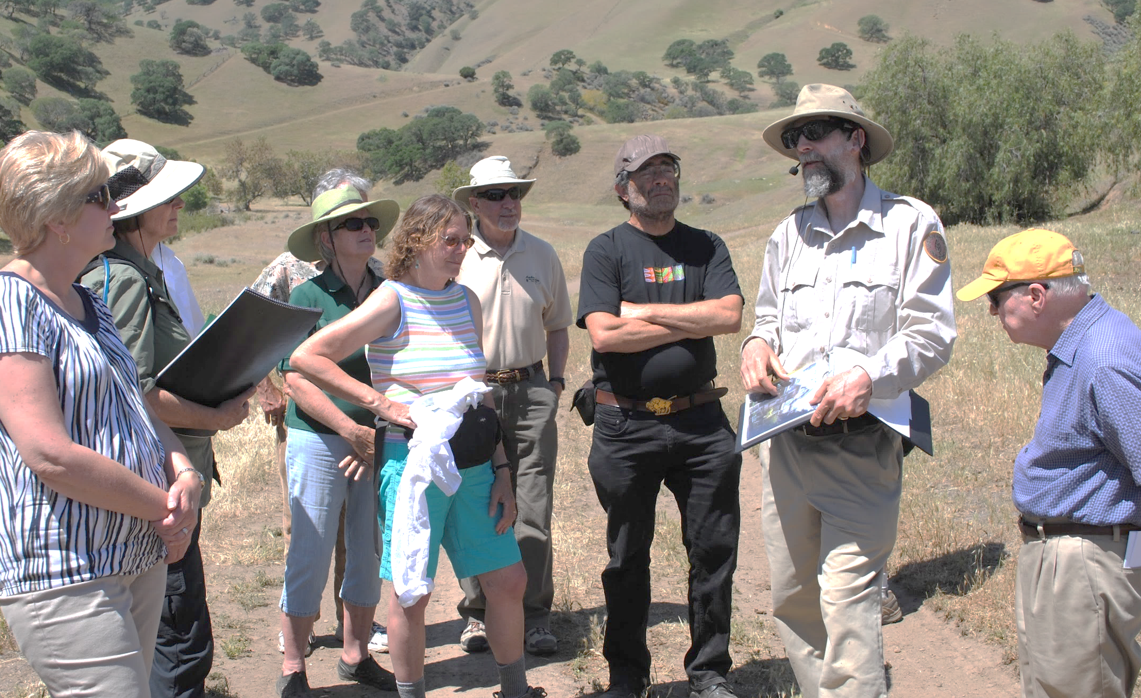
Taking Space
Open body
Neutral: mountain pose from yoga
Square your body to project authority
Give them the gesture, instead of
the finger!
Notes:
Shoulders in line with face

Slide 26
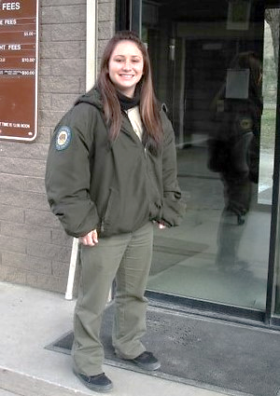
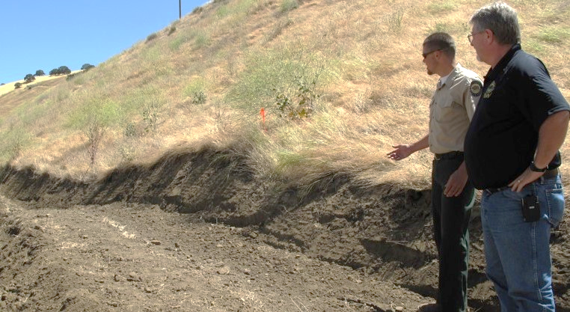
Giving Space
Where you look
Look with whole body
Don’t upstage
Relaxed position
Notes:
Turned head is opposite of squaring body

Slide 27
Shifting Space
Move, stop, backtrack
Switch between giving & taking space
  in groups, answering questions
Cheat out or step away
  avoids private conversations
Squat to look at small or low things

Slide 28

Working with your Brain
Say “yes, and,” instead of “no, but”
Let’s play games!
  Yes, And
  Two Sticks
  Hot Spot

Slide 29
Putting it Together
Warm up body, voice, brain daily
Practice in small moments
Record yourself and/or use a mirror
Professional development & improvement
Notes:
Remember, this is just a quick intro, the flash mob version
There are many more refinements you can learn and practice.
Even the pros do this (NPR voice announcer, Jessica Hansen has morphed over the past months from uber sugary to more level.)

Slide 30
Resources
Borok Consulting & Training
Borokconsulting@gmail.com
CA State Railroad Museum
Lisa.borok@parks.ca.gov
See handouts!
Check out voice teachers
Listen to voices you like

Slide 31
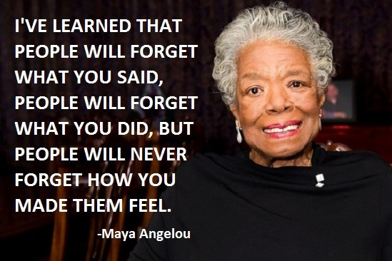
Notes:
Take Q&A

