Slide 1
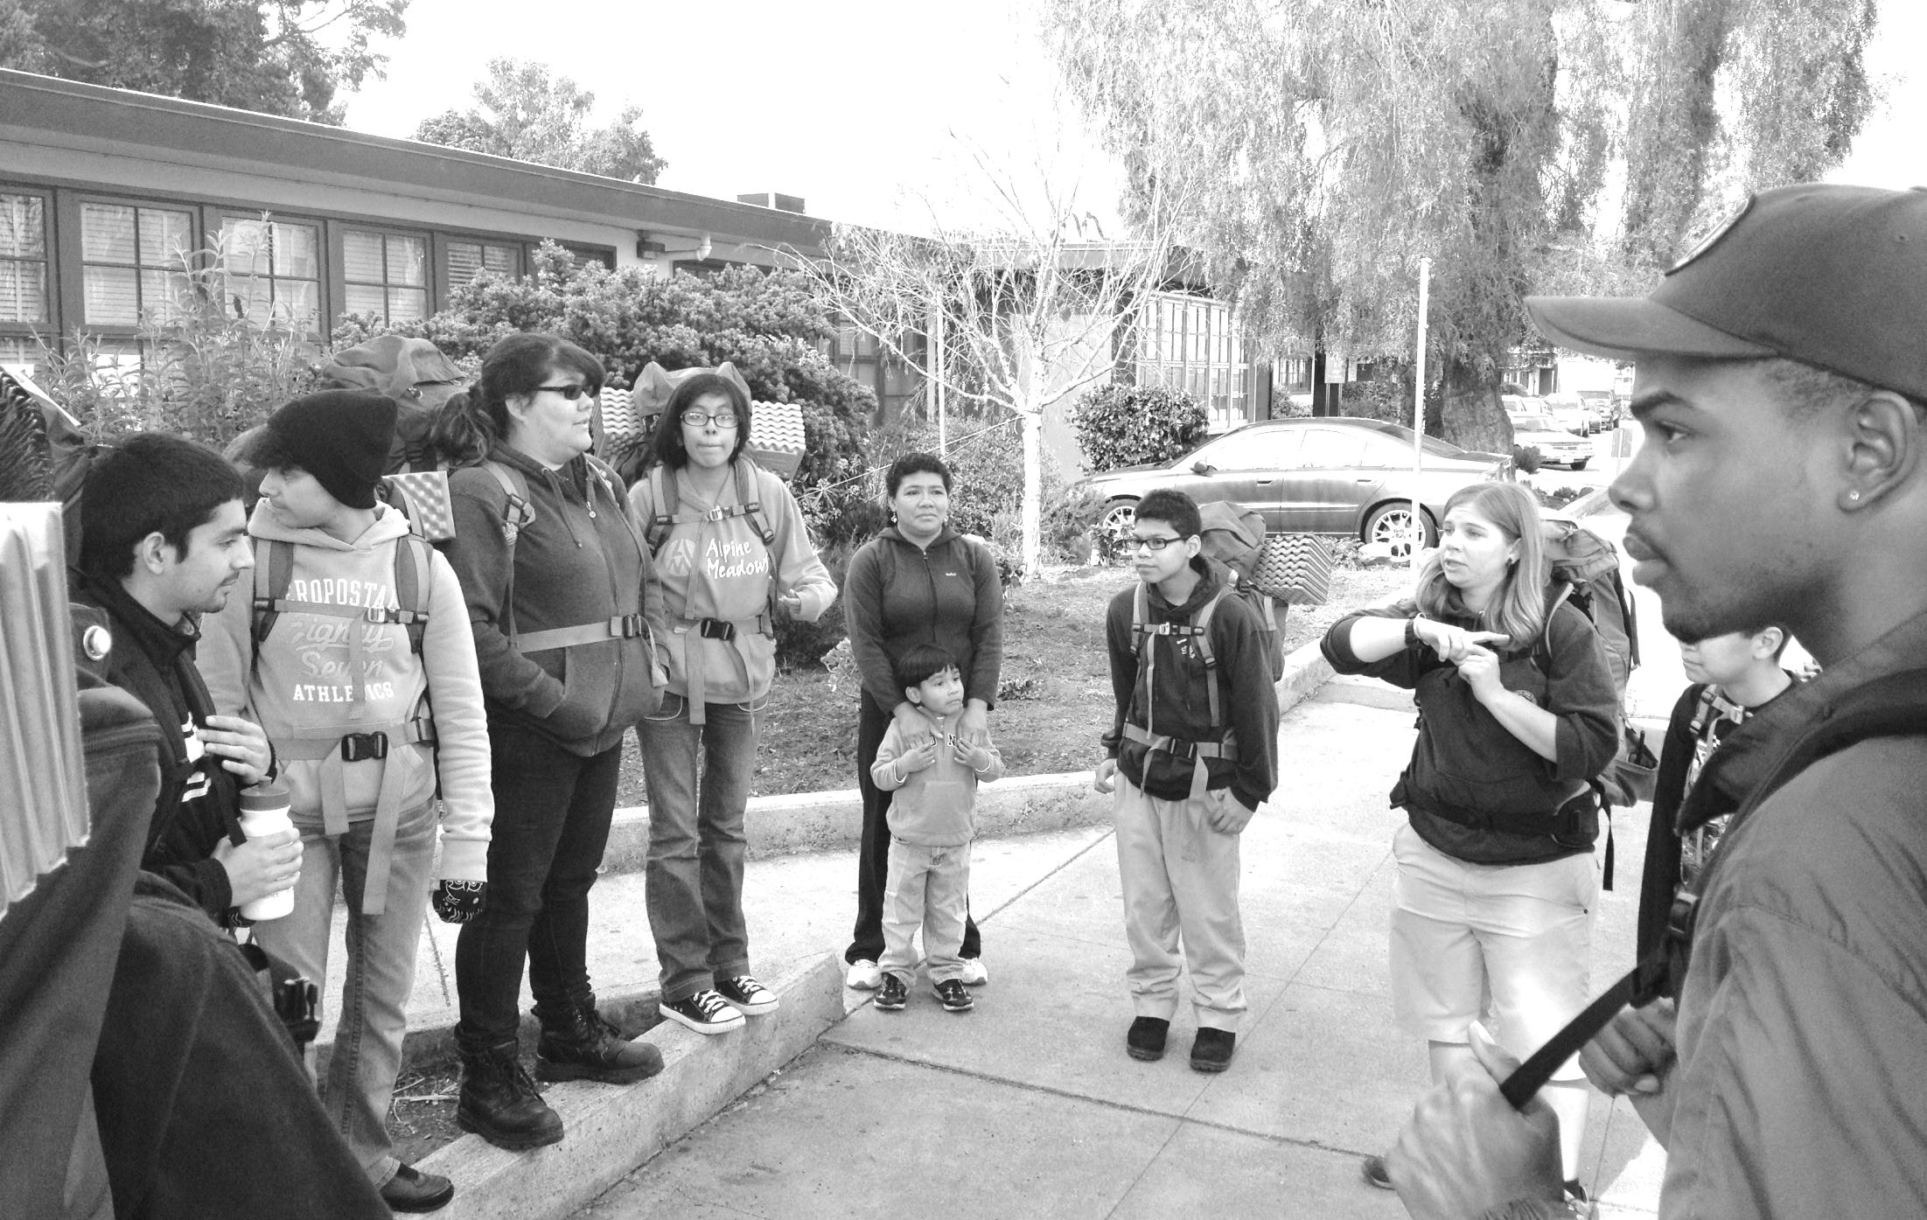
Raising Your Communities Voice!
Philip Coffin, Recreation Coordinator
Jaimee Rizzotti, Community Outreach Coordinator
Reyna Oceguera, Community Outreach Intern
Notes:
Welcome slide
Intros

Slide 2
Workshop Overview
Story
Overview of East Bay Regional Park District
Conducting a Community Needs Assessment
Results
Program Success Story
Group Activity
Wrap Up
Notes:
Philip

Slide 3
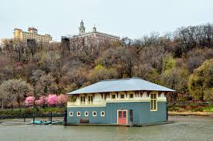
But first…..
A Community Engagement Fail
Notes:
Philip tell QUICK story: Philip tell QUICK story: I worked from 2001 to 2007 as the Education Director for an environmental nonprofit in New York City found by a prominent entertainer and led by a Board of Directors who were mostly wealthy white Upper East Siders. To much fanfare and with lavish parties, in 2004, our non-profit opened up the Peter Jay Sharp Boathouse at Sherman Creek Park in Upper Manhattan. We had cleaned up this neglected park, and were managing it for the City of New York Parks Dept. We had invested millions of dollars in restoring and rebuilding this waterfront park, and planted a beautiful botanical garden-like oasis with a pond, fountain, winding paths, and access to the Harlem River. And the state-of-the-art floating boathouse, which was leased to a non-profit rowing organization, Row New York, sat on the Harlem River, adjacent to the park. The premise was always that we were going to get local Washington Heights and South Bronx youth excited about rowing, and help them ‘get off the streets’ and train in this great sport, and get athletic scholarships to major universities. Well guess what happened: in my years there, I observed mostly white kids from other neighborhoods participating and very little interest from the local high school. At the same time, the new park was rarely visited, despite being across the street from a major housing project and next door to an elementary school. When we asked local families and school teachers why they didn’t visit the park, we heard that: it looks like a private park, there are no signs in Spanish, it closes at 5pm when I get back to work, there’s nothing to do there, there’s no play structure for my kids.
This was an expensive example of poor community engagement and planning. To my knowledge, our non-profit never held community meetings, distributed surveys, or conducted any kind of community assessment. So naturally they designed and built a facility that didn’t meet community needs and was thus underutilized. Hopefully things have changed in the 10 years since I moved back from New York, but this has always stood out to me as an example of misguided park and program planning.

Slide 4
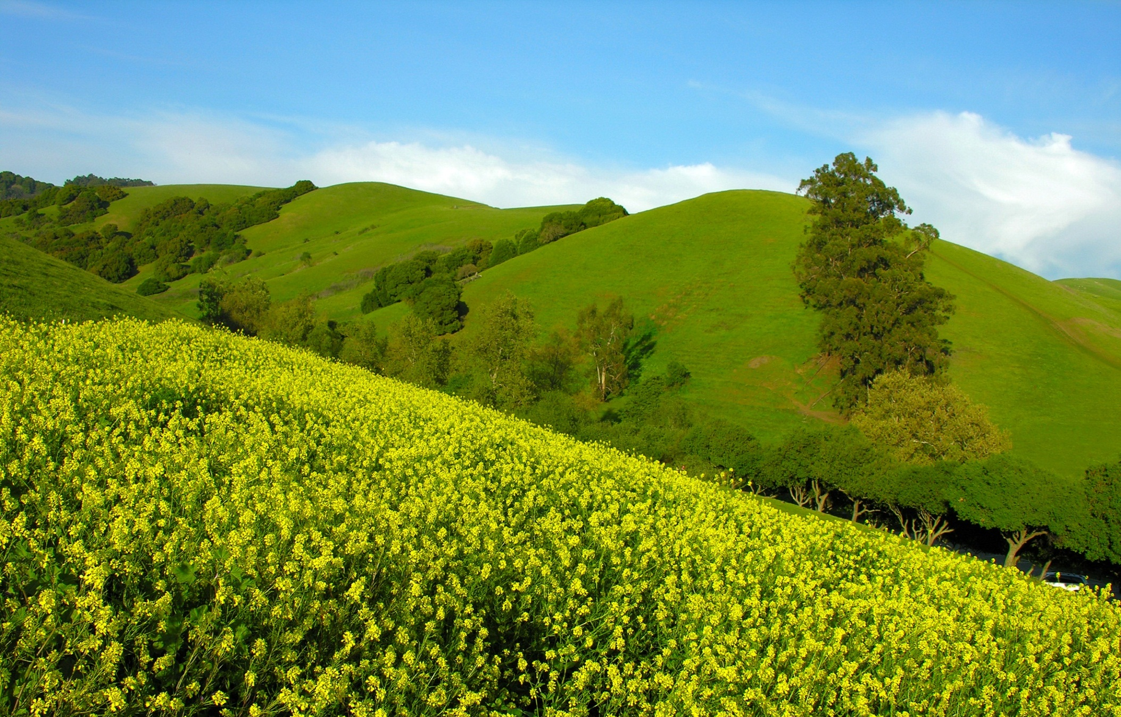
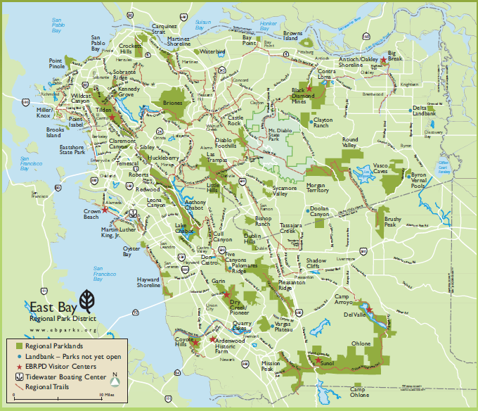
EBRPD Today
Nation’s Largest Regional Park Agency
120,931 Acres
65 Regional Parks
1,250 miles of trails
Two counties: 2.5 million residents
25 million visits per year
Notes:
Jaimee

Slide 5
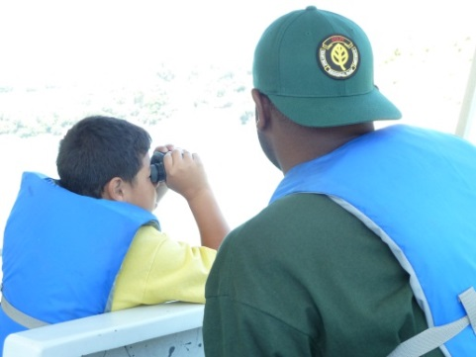
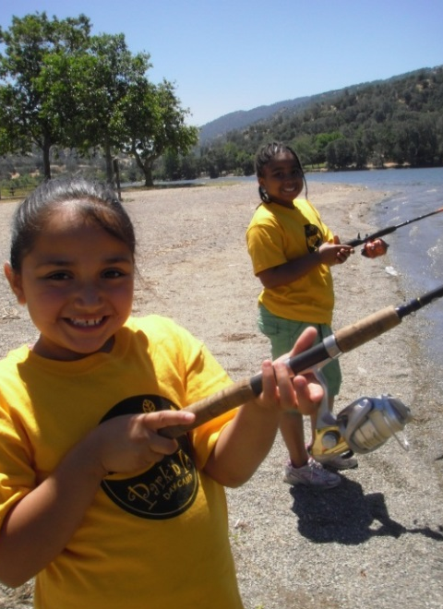
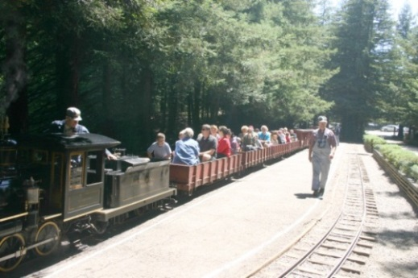
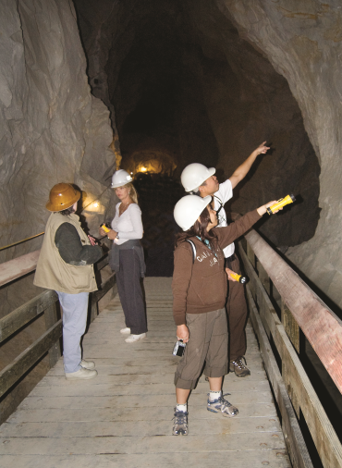
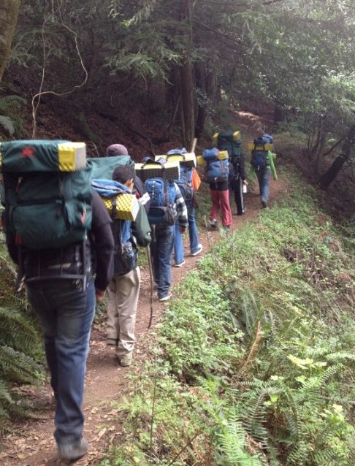
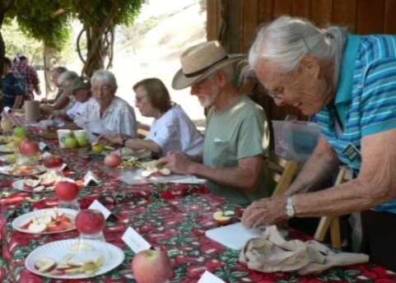
Offering Unique Outdoor Programs and Experiences
Notes:
Philip

Slide 6
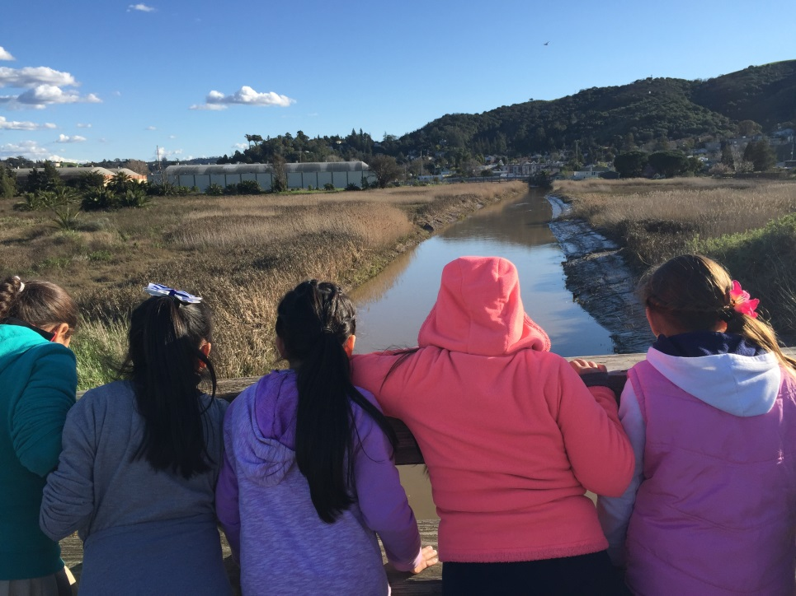
Goals for the Community Needs Assessment
Identify Community’s interpretive and recreation needs
Analyze current program offerings
Make program recommendations based of identified needs
Understand:
  Barriers to accessing parks
  Current community involvement in the parks
Notes:
Reyna

Slide 7
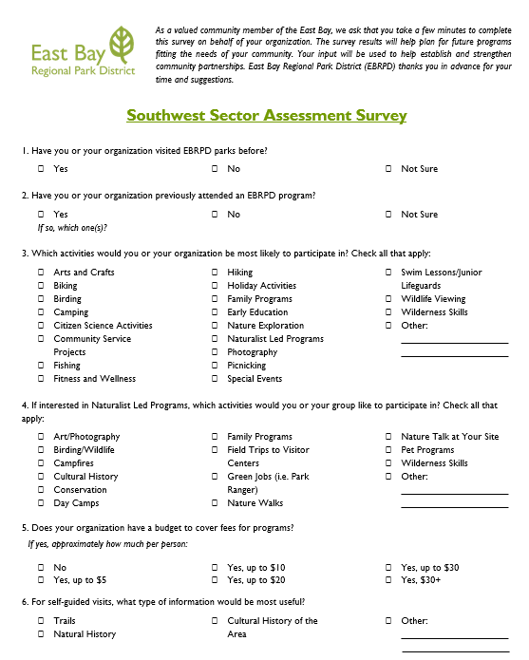
Process
Assessment of Database
  Purchased database, modified to fit specific needs:
    Locations
    Types of organizations
    Contact information
Development of Survey
  Referencing prior assessments
  Worked with location-specific Interpretive staff
  Electronic and hard copy
Notes:
Reyna

Slide 8
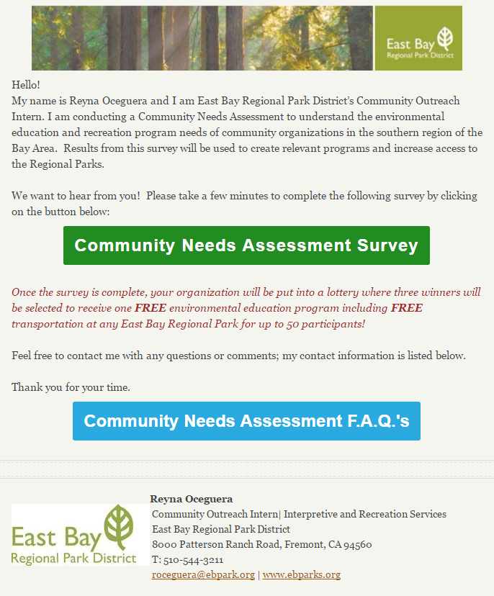


Process
550 organizations surveyed over two months
Various outreach methods
  Email
  Mail
  In person (pre-scheduled by phone & drop in)
  ∗ Drop in and email were the most successful methods
Offered Incentives
Software:
  MailChimp: to send out email with survey link and track clicks/opens
  Survey Monkey: track and analyze survey results
Notes:
Reyna

Slide 9
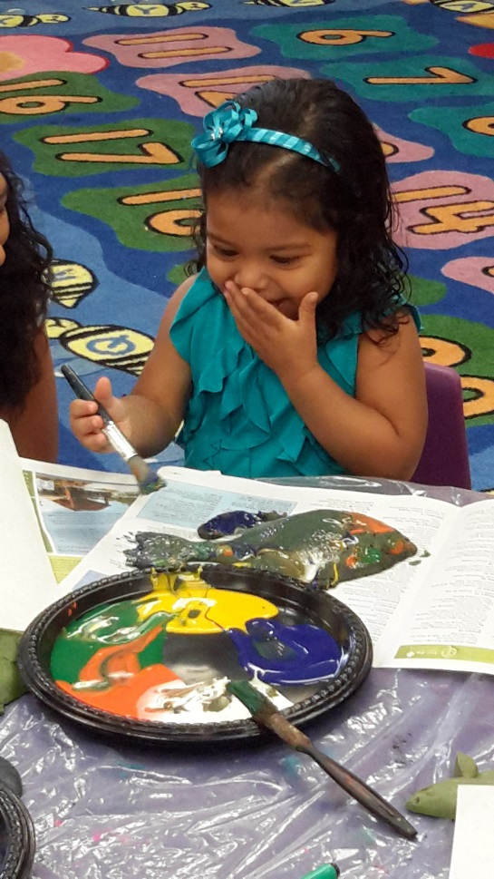
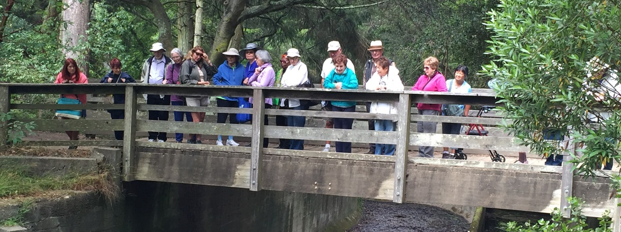
Community Needs Assessment
Received survey results from a total of 57 organizations (11.4% response rate)
      (7) Schools
      (6) Faith-Based Organizations
      (18) Community Organizations
      (10) Social Services
      (4) Senior Serving Organizations
      (6) Youth Serving Organizations
      (6) Not Specified
Notes:
Reyna

Slide 10
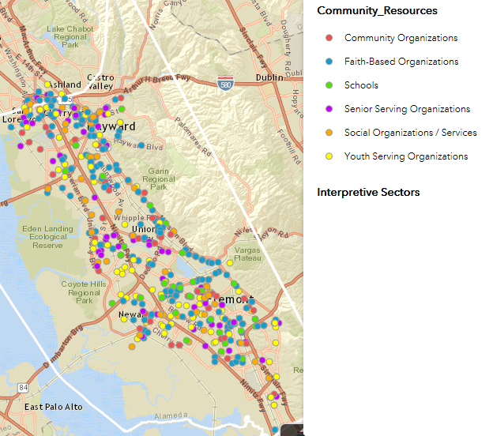
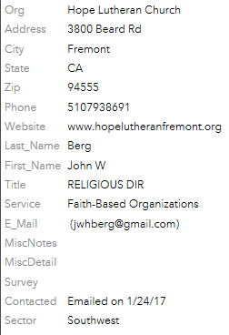
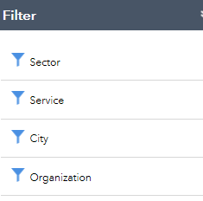
Database snapshot
Notes:
Jaimee

Slide 11
Results
89% of organizations have visited an EBRPD Park
39% have attended an EBRPD program
59% of organizations have no budget to pay for programs 24% can pay up to $5/person
73% of organizations may be interested in volunteering with EBRPD
73% of organizations have not partnered with EBRPD
Notes:
Jaimee

Slide 12
Which activities would you or your organization be most likely to participate in? Check all that apply:
Notes:
Jaimee
They offer hiking programs and no one shows up

Slide 13
If interested in Naturalist Led Programs, which activities would you or your group like to participate in? Check all that apply:
Notes:
Jaimee

Slide 14
If you are a school group, please select all program topics you would be interested in:
For self-guided visits, what type of information would be most useful?
Notes:
Cultural history is currently biggest request from school groups

Slide 15
Check any of the following that might be barriers to you or your organization’s participation in EBRPD programs:
Notes:
Majority of programs are free – so is it perceived cost? How do we get accurate information out there
Safety is a concern for almost ¼ of respondents

Slide 16
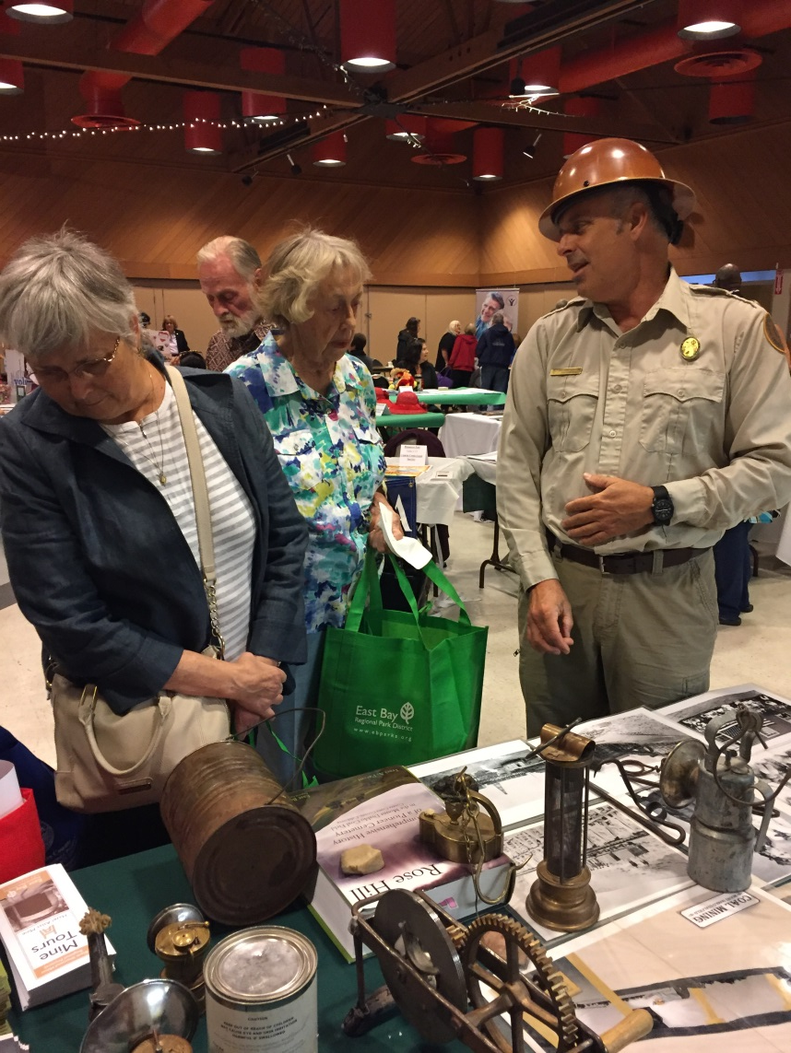
Recommendations
Site visits, drop in or pre-scheduled
Research where you are going/who to connect with
Use of tablet instead of paper
Use of other outlets like social media
Compare park user and non-user data
Community meetings/ focus groups
Focus of demographics and language
Follow up!
Notes:
Reyna – consolodite future assessment recommendations and ebrpd staff recommendations – make less wordy. Look at notes

Slide 17
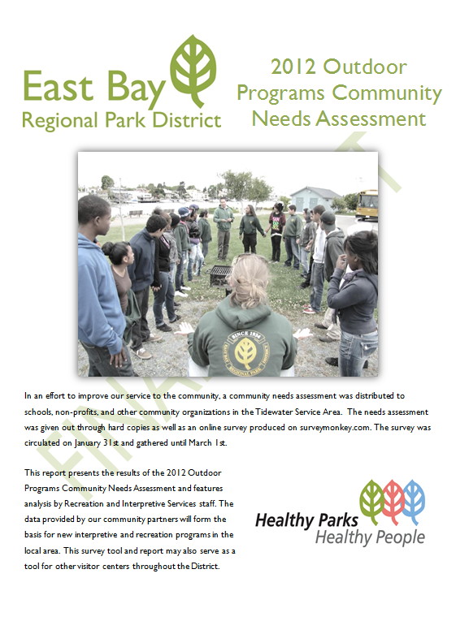
Tidewater Service Area Community Needs Assessment
Where is the Tidewater Boating Center?
What programs does the Outdoor Recreation Department offer?
What kind of personal, environmental, and community health concerns do our East Oakland neighbors have?
What kinds of barriers to the outdoors exist in our neighborhood?
What kinds of programs and services do our East Oakland neighbors want?
Notes:
Presenter: Philip

Slide 18
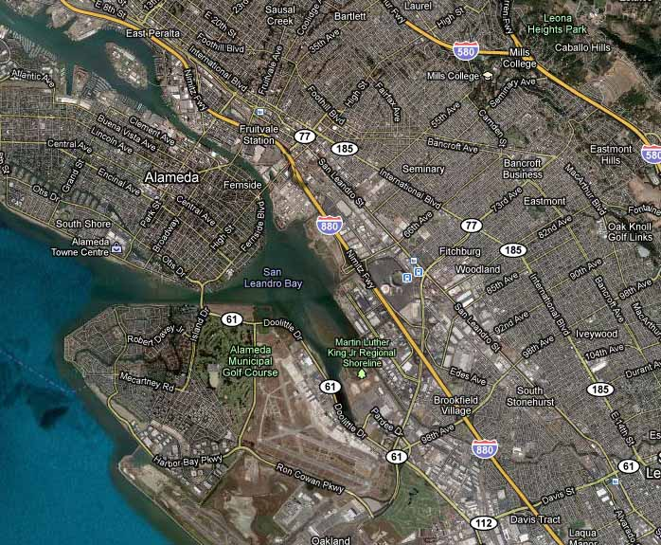
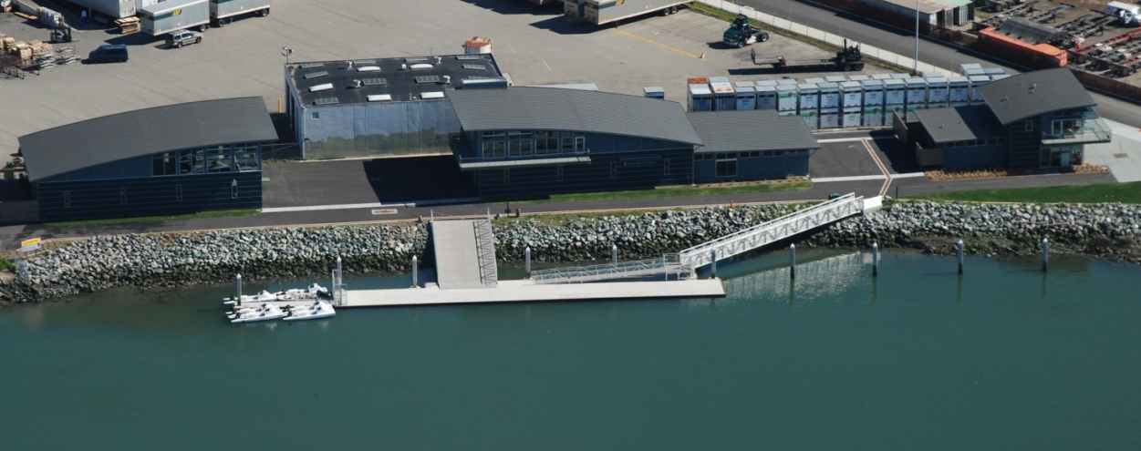
Tidewater Boating Center
Oakland estuary between Oakland and Alameda
Tidewater Boating Center – aerial view
Notes:
Philip

Slide 19
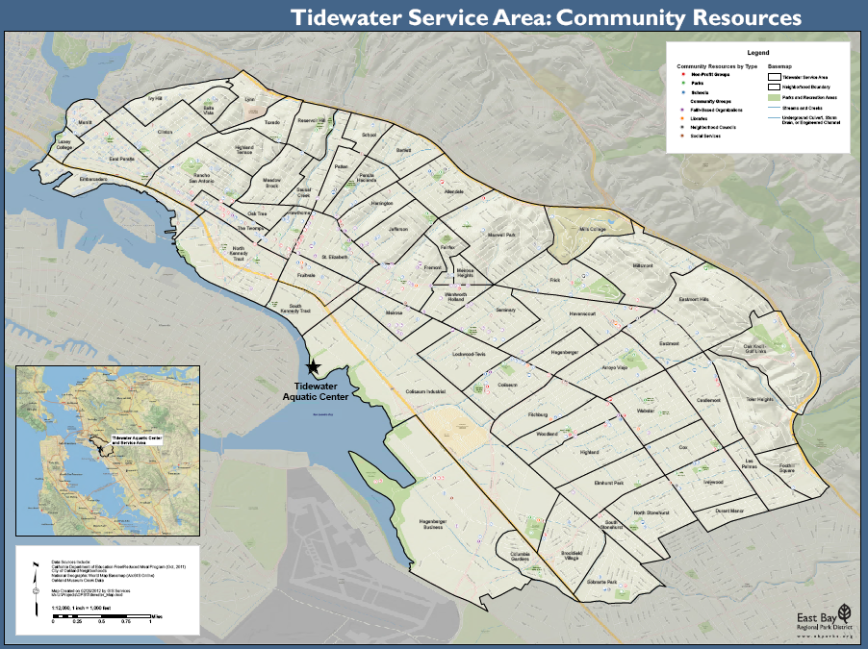
Notes:
Presenter: Philip

Slide 20
Community Needs Assessment Results
Personal Health Concerns: obesity, diabetes, poor nutrition
Community Health Concerns: gang violence, drugs
Environmental Health Concerns: pollution
Barriers to visiting Regional Parks: transportation, costs, awareness of parks

Slide 21
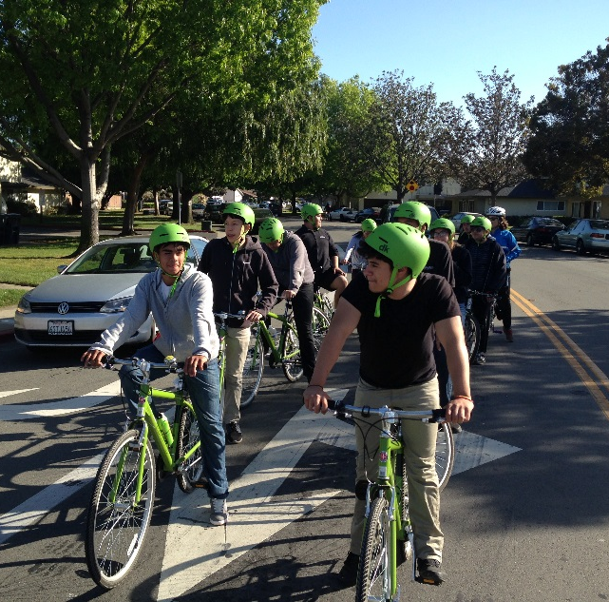
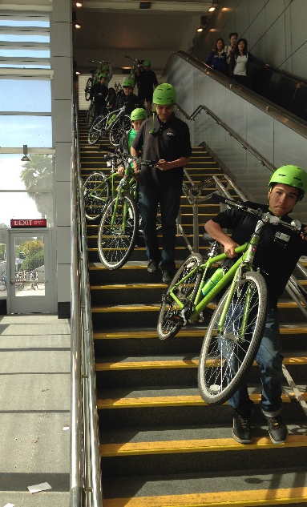
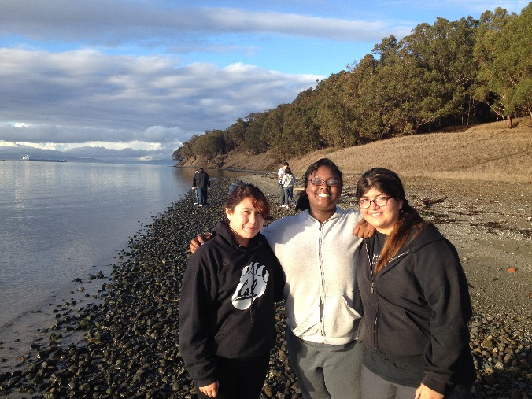
New Program in 2013: Teen After School Biking
In partnership with Lighthouse Community Charter High School
Every Wednesday from 1:45 to 6:00pm
We ride from the school, or utilize public transit, or take a shuttle bus
We teach biking skills, safe street riding, and how to reach their Regional Parks by bike

Slide 22
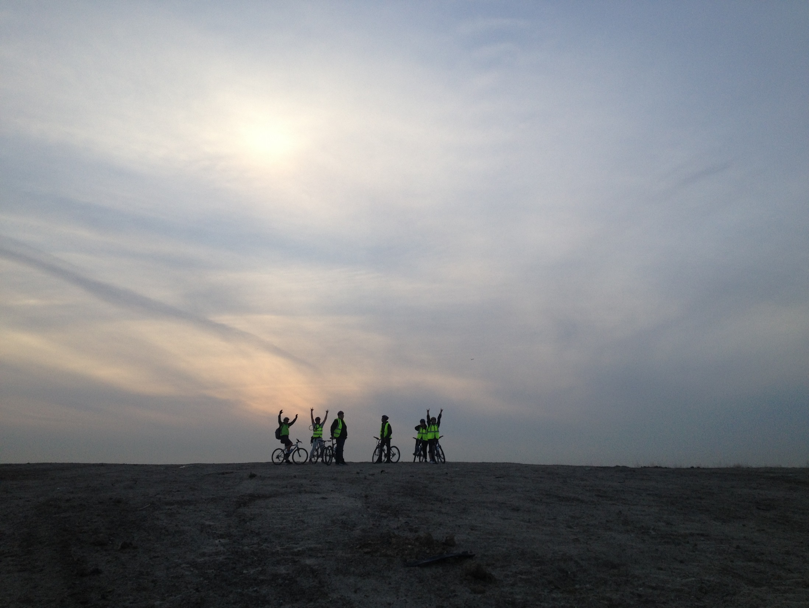
Teen Afterschool Biking
“It’s funny, but ever since I joined this bike club, I haven’t been to McDonald’s or Burger King.”
–Alessandra, 2013 Teen Afterschool Biking participant
Notes:
Philip

Slide 23
Scenarios
Break into groups of no more than 5 people
We are giving you results from your community needs assessment. Develop a program outline to present to your Board of Directors based off this information.
Present your program and your outreach strategy
Notes:
Jaimee

Slide 24
Key Questions When Planning Your Needs Assessment
What are the goals of the assessment?
What information do you want about your population?
What information do you want from your community?
Who will you reach out to for this information?
How can you gather that information? With what tools?
What will you do with the data?
Notes:
Philip

Slide 25
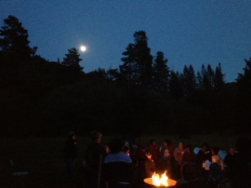
Conclusions
Thank you for attending Raising Your Community’s Voice!
Visit us at www.ebparks.org
Notes:
Reyna

