Slide 1
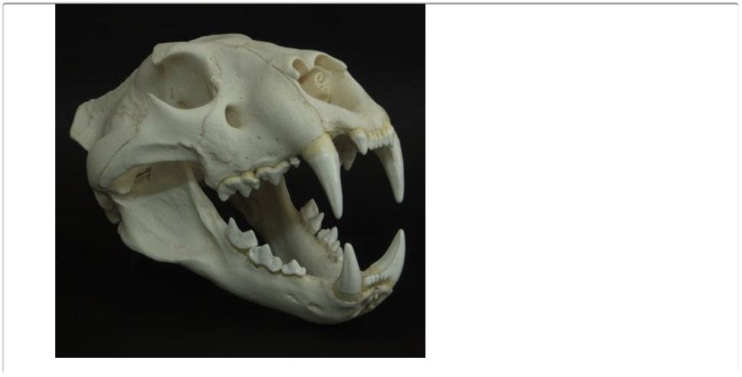
Bones, Feathers and Fur:
Grabbing Visitor’s Interest with Hand-Held Objects

Slide 2
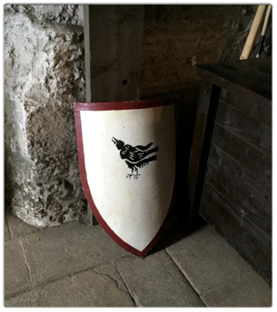
Terms
  ARTIFACTS
  BIOFACTS
  HAND HELD OBJECTS
  PHYSICAL OBJECTS

Slide 3

How We Learn
  How the Brain is Wired
  Sensory Literacy
  Common Core and Next Generation Science Standards

Slide 4
Brain Wiring
.

Slide 5
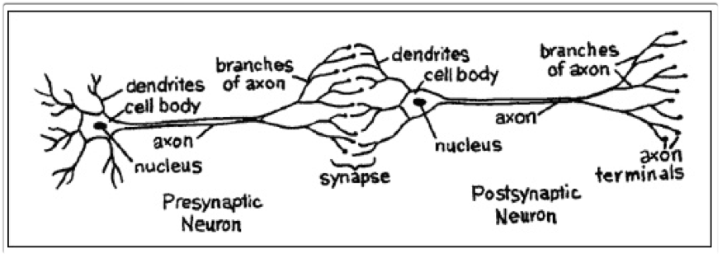
Brain Wiring Communications
  specialized cells called Neurons
  Dendritic Branches Extend from Neurons: receptor sites
  Axon carry and relay Electric messages away from the cell body to other cells
  synapse is where the Electrical messages convert into chemical message (Neurotransmitters) jumps the space and then is reconverted into an electrical impulse. (ions)

Slide 6
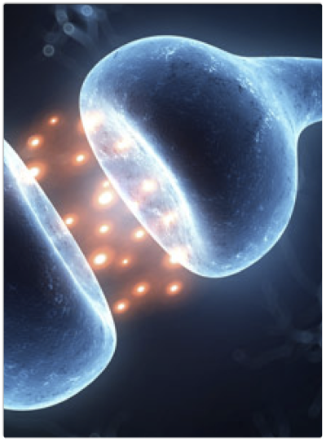
Learning: The Strength of Connections
Plasticity: change of the strength and weakness of connections
Over production of Synapses: Takes place in the first years
Synaptic Pruning Shed old synapses to make room for higher quality connections
adding New synapses Neurogenesis through Life

Slide 7
Developmental Learning
Ages 4-7: Right brain develops through visual and spacial activities.
Age 10: Left brain develops analytic and language skills
Brain development timed to take advantage of developmental experiences such as observing and analyzing data.
Synaptic Pruning: 1st-Early Childhood 2nd-Adolescence through late 20s.

Slide 8
In Summary
From experiences, we build connections in the brain.
Connections are reinforced or weeded out by more refined stimuli.
Plasticity enables growth in and between brain regions crucial to advanced thinking.
This process is not only sensitive to experience, it is actually driven by experience.
Synapse addition probably lies at the base of some, or even most, forms of memory.

Slide 9

How do we create —the best learning environments —the most memorable events for audiences of all ages?

Slide 10
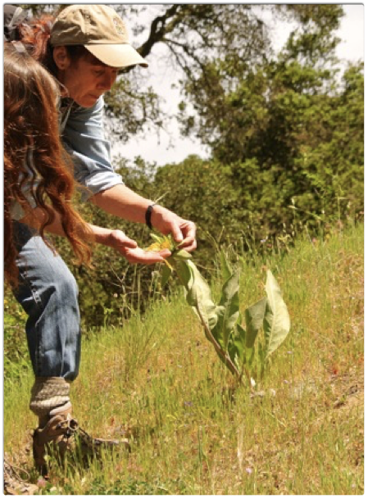
Sensory Literacy
.

Slide 11

Which Reality do we live in?
20th Century
Augmented
Virtual

Slide 12

Are we loosing our sensory vocabulary?
Which parts of the brain are in use?
What synaptic pruning happens if we will lose those original connections in our brain?
The more senses stimulated the deeper the impression.

Slide 13

Advantages of Sensory Learning and Play
Builds motor skills
Facilitates learning letters and numbers
Builds the ability to analyze information through active learning
Allows for physical understanding of language
Strengthens meaning of words and concepts.

Slide 14
Learning Styles: Auditory, visual, Kinesthetic
.

Slide 15
How do we Provide Sensory Literacy?
Ladan Shams, UCLA, Aaron R. Seitz, UC Riverside
Multi sensory exposure invoked by a uni-sensory component.
A flower- count the stamen, feel the petals, release the pollen, reflect on how you feel about it

Slide 16
  Common Core & Next Generation Science Standards

Slide 17
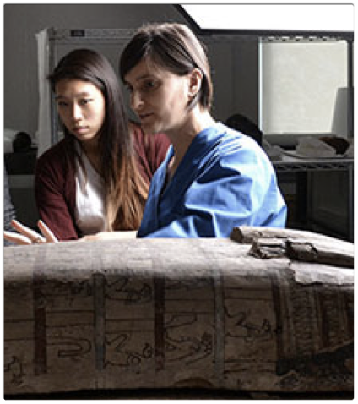
How Are Sensory Literacy & Hand Held Objects related to standards?
Hand-held objects encourage the best aspects of play
  exploration
  discovery on multiple levels
Using evidence compiled through senses
  permits students to articulate discovered evidence
  contributes to analysis
  opens for best explanations

Slide 18
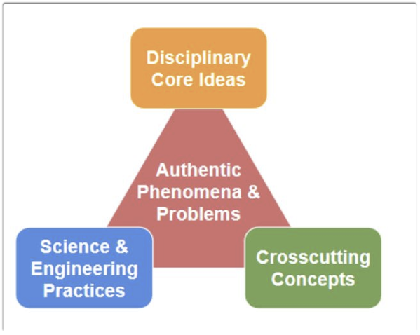
Summary of NGSS: It Outlines:
What scientists/engineers know (Core Ideas)
What they do (Practices)
How do they think (Concepts)

Slide 19
Disciplinary Core Ideas
Life Science (LS)
Physical Science(PS)
Earth and Space(ESS)
Science and Engineering, Technology and Applied Science(ETS)

Slide 20
Science and Engineering Practices
Asking questions and constructing explanations
(for science)
Defining problems and designing solutions
(for engineering)

Slide 21
Science and Engineering Practices
Developing Models
Doing Investigations
Analyzing and Interpreting Data

Slide 22
Science and Engineering Practices
Math and computational thinking
Discussing ideas based on evidence
Obtaining, Evaluating & Communicating information

Slide 23
Cross Cutting Concepts- 7 Important Tools
Patterns
Cause and Effect
Scale Proportion/Quantity
Systems/System Models
Energy & Matter: Flows, Cycles and Conservation
Structure & Function
Stability & Change

Slide 24
NGSS in Action
In your Journal…
Identify which SCIENCE AND ENGINEERING PRACTICES were used or could have been used as you progressed through the activity
  —Models —Investigations
  —Data — Evidence
  —Math and computational thinking
  —Communicating information
We will be working in the life science area today. (CORE IDEAS) If you identify any other connections, write it in your journal

Slide 25
Come to Your senses

