Slide 1
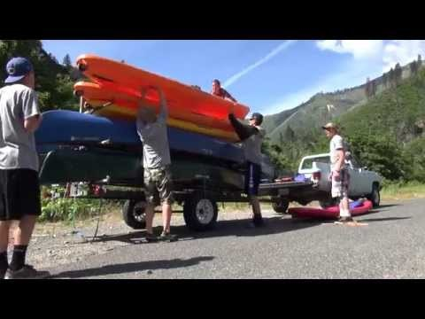

Slide 2



Plumas Unified School District & Plumas National Forest
Fire Restoration Agreement
Inspiring stewardship through collaboration, education, and restoration
USDA is an equal opportunity provider and employer
Notes:
Good morning and thank you for the opportunity to be here today to present a brief introduction to the Plumas Unified School District and Lassen & Plumas NF’s Storrie Fire Restoration Agreement, where we are committed to inspiring stewardship through collaboration, education, and restoration as partners.

Slide 3
Fire Restoration Strategy
Goal:
To undertake improvement, protection, and rehabilitation actions
  on National Forest Service lands rendered necessary by the Storrie & Moonlight Fires
  consistent with the legal record leading to the settlement agreement
Implement projects to address three categories of damages determined by the judge
Notes:
Our forests created a restoration strategy consistent with the legal findings. Paralleling our Forest Service mission, we are to improve, protect, and rehabilitate areas on both forests as a result of the Storrie Fire.

Slide 4
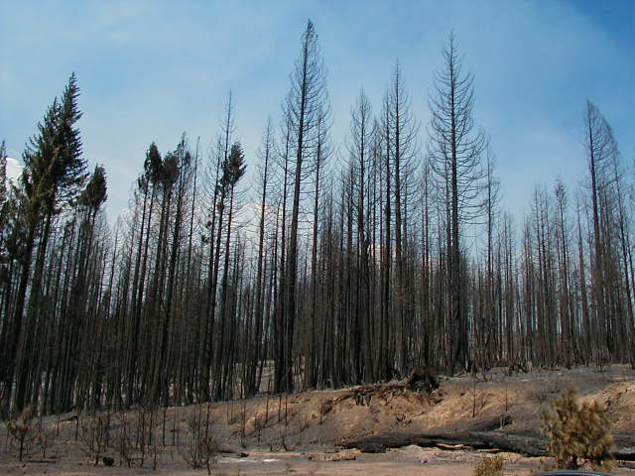
Forest structure: timber
Notes:
Timber: young trees and old growth,

Slide 5
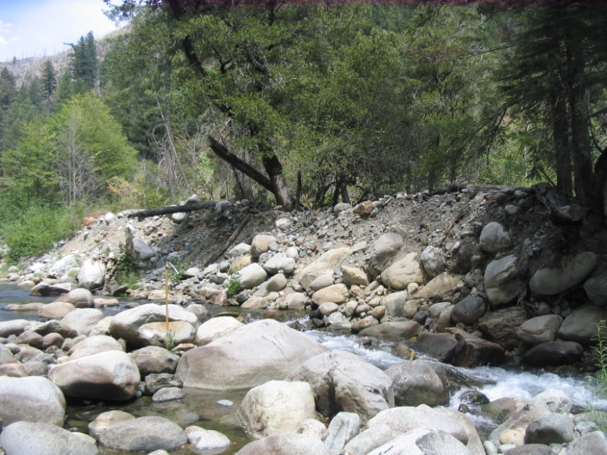
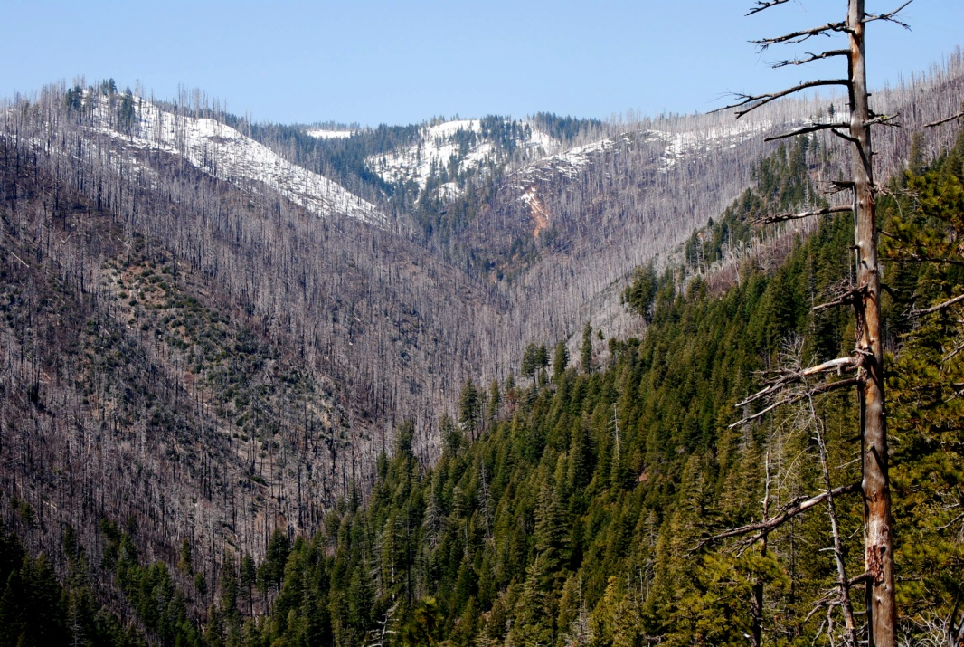
Natural resources: non-timber
Notes:
soil; wildlife and habitat for terrestrial and aquatic species,

Slide 6
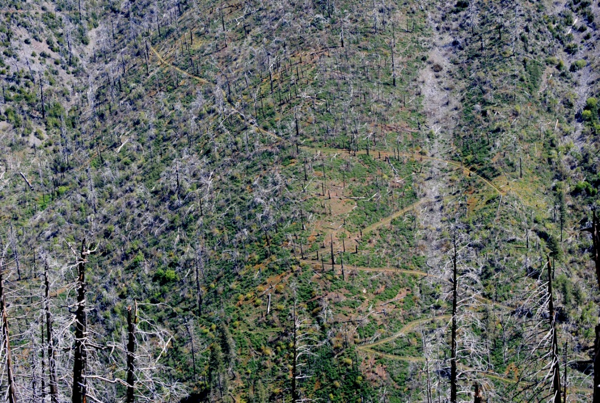
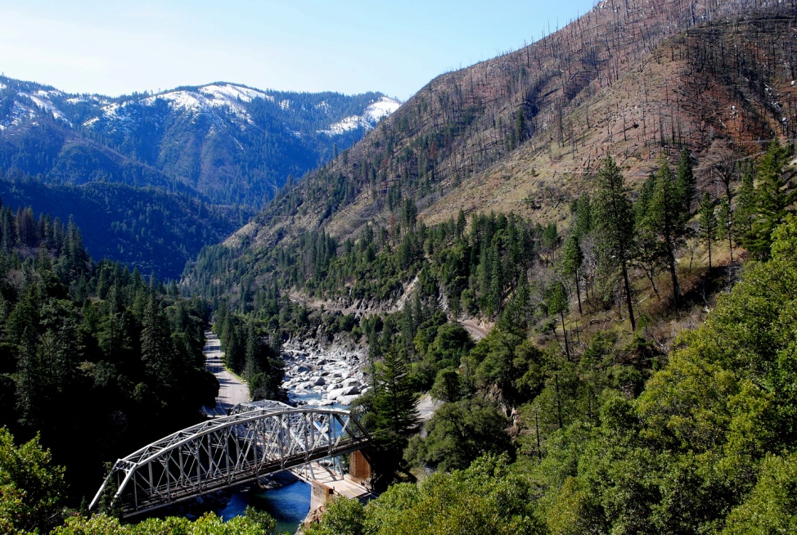
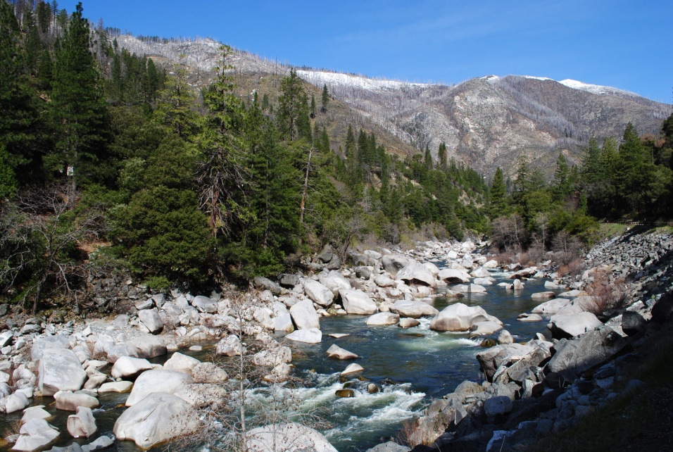
Recreation/scenic values
Notes:
recreation opportunities (trails, campgrounds), Hwy 70 Scenic Byway, Pacific Crest Trail, and the aesthetic and scenic enjoyment values.

Slide 7

PUSD/FS Fire
Collaboration Model
Organizational mission overlap:
PUSD: “Inspiring personal achievement, citizenship, &
academic success”
Restoration & student learning
USFS: “ Caring for the land and serving people”
Notes:
Through our collaboration, Plumas Unified School District mission to inspire personal achievement, citizenship, and academic success merges with the Forest Service mission of caring for the land and serving people.

Slide 8
PUSD/Fire Restoration Project Mission:
To restore and sustain the natural and cultural resources of the Storrie & Moonlight Fire areas, while enhancing student learning and stewardship through effective community collaboration
Notes:
Our collaborative mission is to:

Slide 9
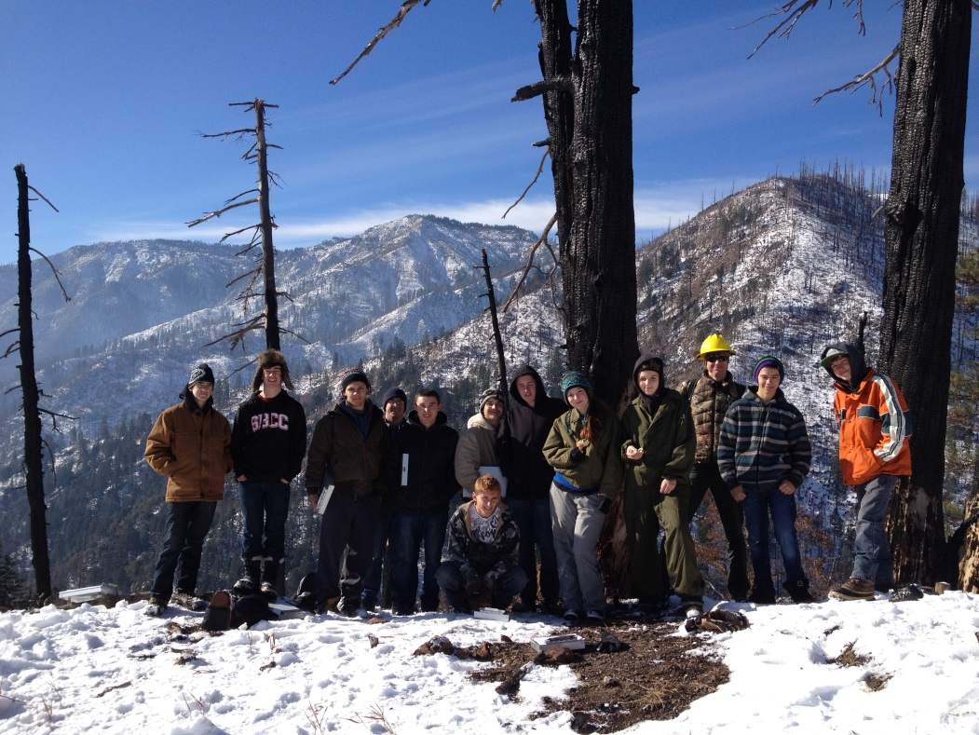
Strategic Goals
Education
Restoration
Community
Notes:
While there are 13 strategic goals, they fall into the three categories of education, restoration, and community

Slide 10
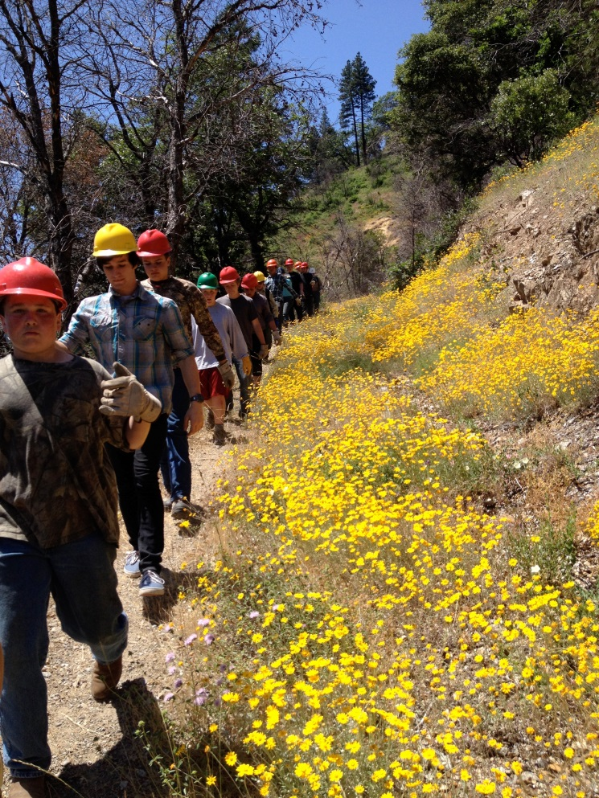
Education
3-12 grade NGSS curriculum
Natural resource experiences
Fire-related experiences
Innovative methods
Foster stewardship & environmental literacy
Notes:
The goal for education is to utilize Next Generation Science standards-based curriculum, natural resource and fire-related hands-on experiences with new methods. All this helps foster an arena of stewardship for the land.

Slide 11
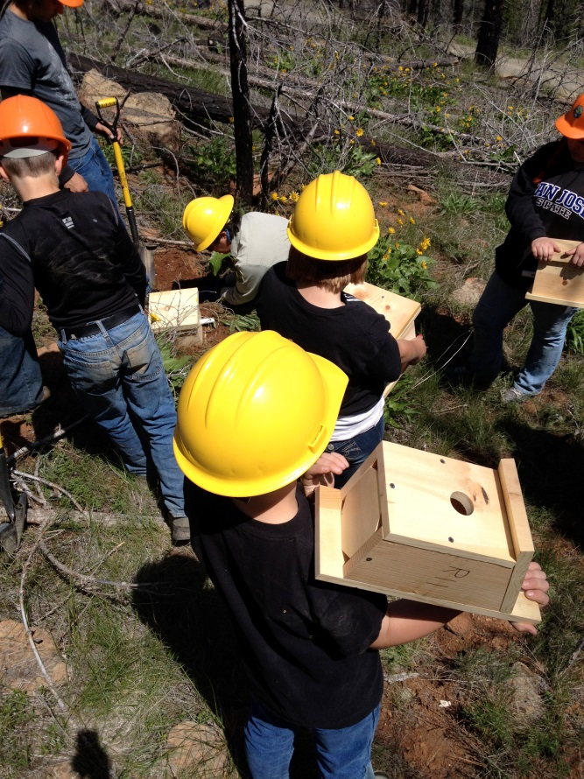
Restoration of natural, cultural, & recreational resources
  Pacific Crest Trail & Feather River Canyon Trails
  Campground rehab
  Rare/Endemic plant propagation
  Tree planting
  Noxious weed control
  Fuels reduction
  Wildlife surveys
  Wildlife habitat restoration
  Planting of native plants
Notes:
Our operating plan identifies specific restoration activities for partnership. These are just a few examples of projects that our students have become involved in.

Slide 12
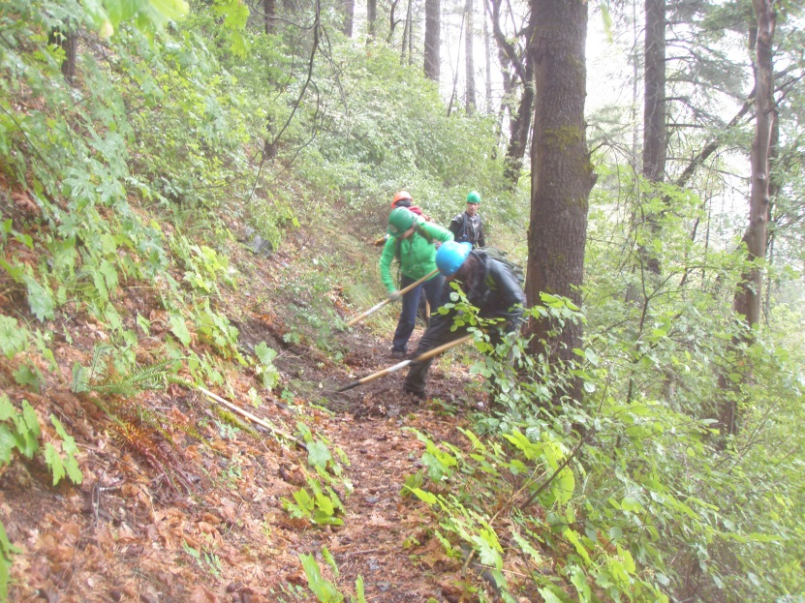
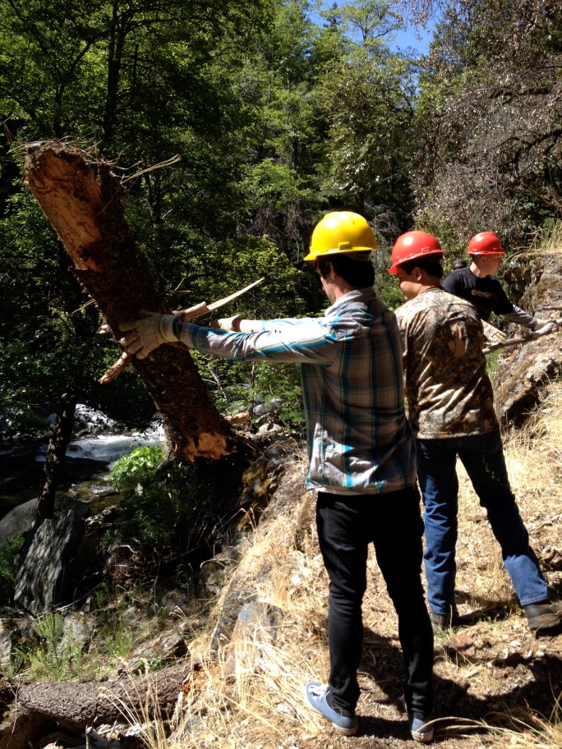
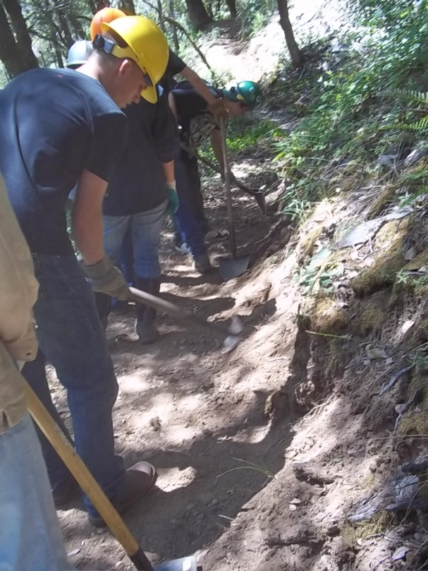
PCT & Feather River Canyon Trails
Notes:
Students are helping to restore and maintain trails in the Feather River Canyon

Slide 13
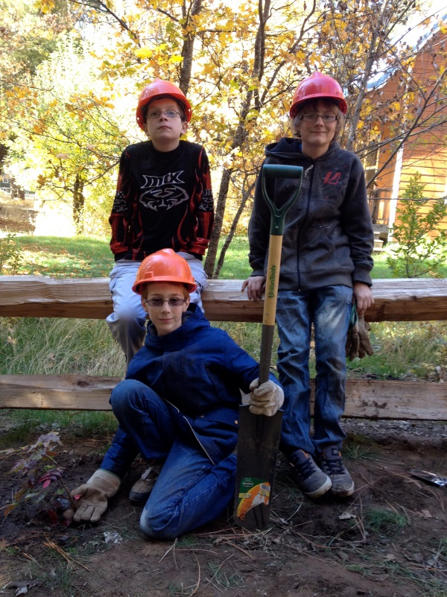
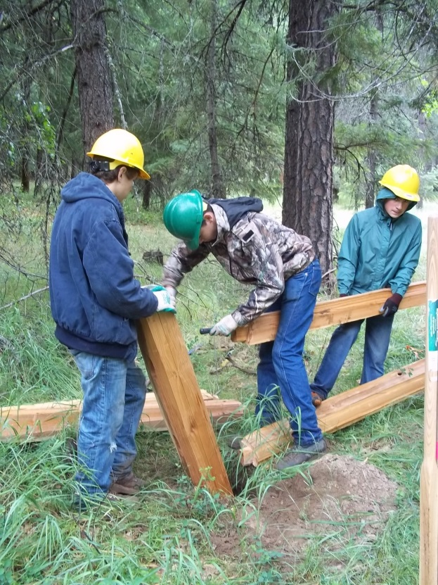
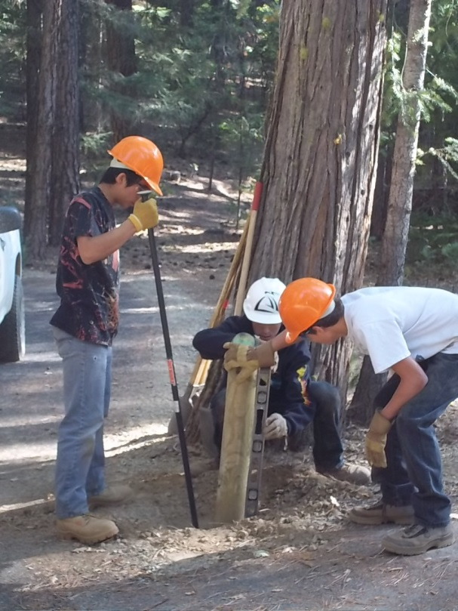
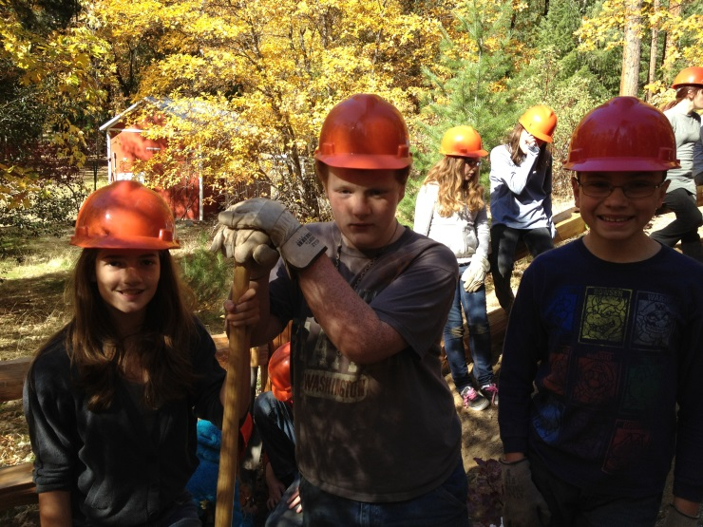
Campground Rehab
Notes:
Students have done significant work in the Hallsted Campground (Rich Fire Restoration Project) such as constructing and installing fence (700 linear ft.), building and installing site markers, installing campfire rings and lantern post, planting native plants and installing drip line for same.

Slide 14
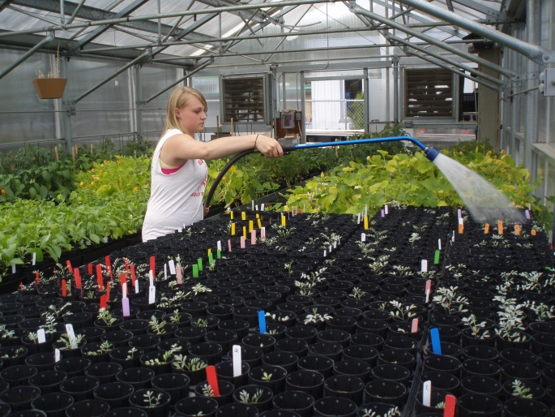
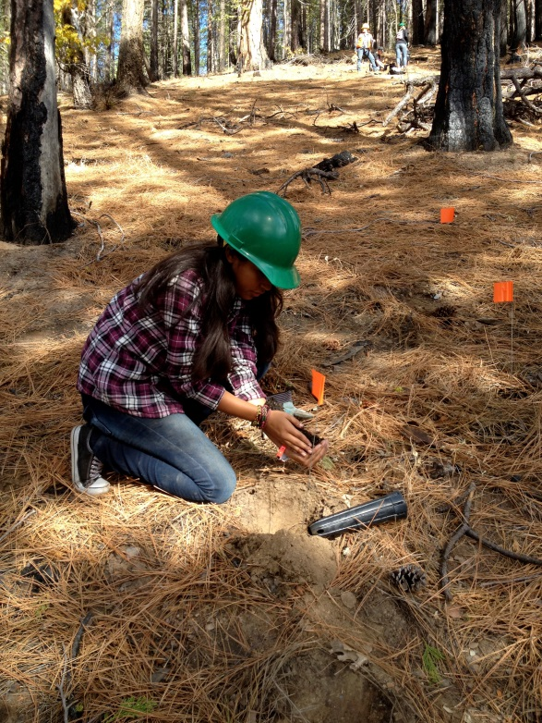
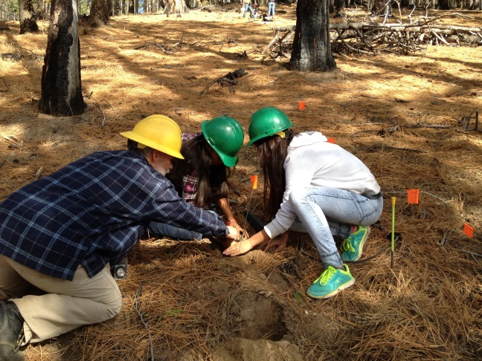
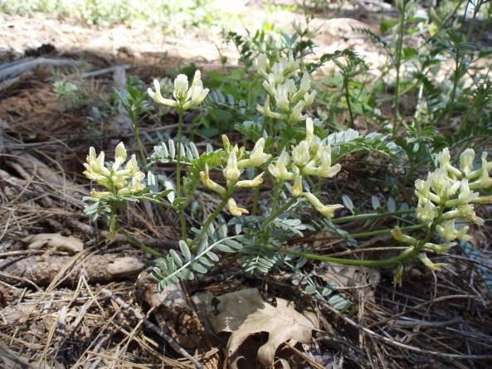
Rare/Endemic Plant Propagation
Notes:
Students are involved in the propagation of a rare, endemic plant Webber’s milkvetch or Astragalus webberi. They scarify and sow seed in Greenville High School’s Greenhouse (February), water and maintain plants during summer (senior project), and plant in autumn. This past October, students from Chester and Greenville High Schools helped our botanists plant.

Slide 15
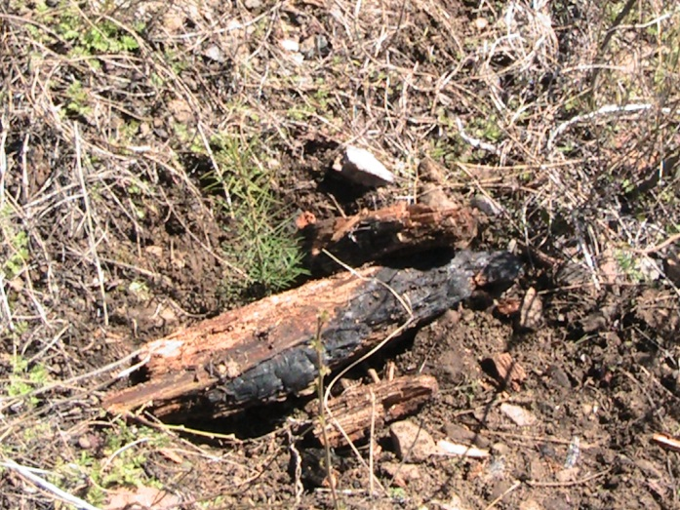
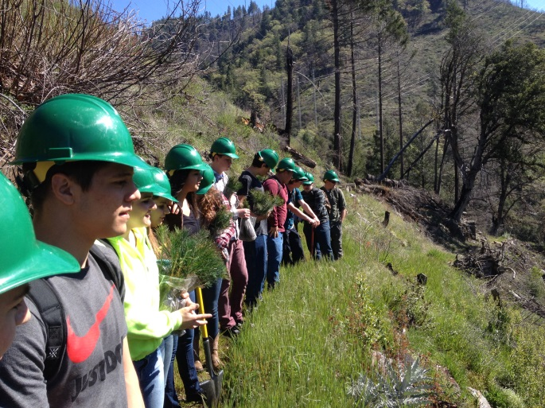
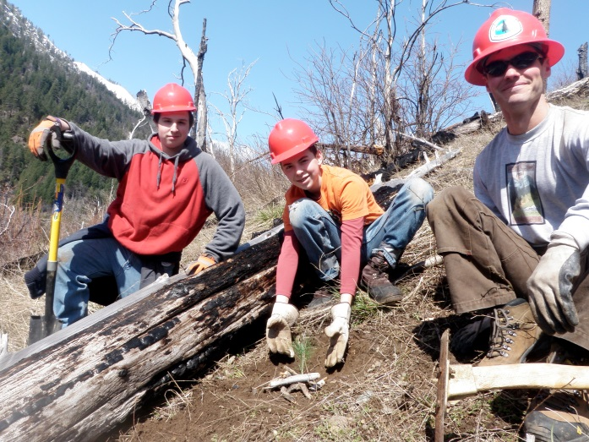
Tree Planting
Notes:
Students have planted around a total of 4 acres of mixed conifer seedlings (several hundred). You can image that due to the steep nature of the canyon, we have some limitations on access.

Slide 16
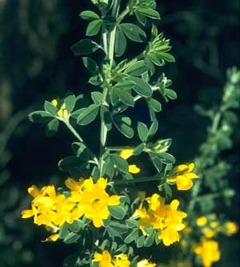
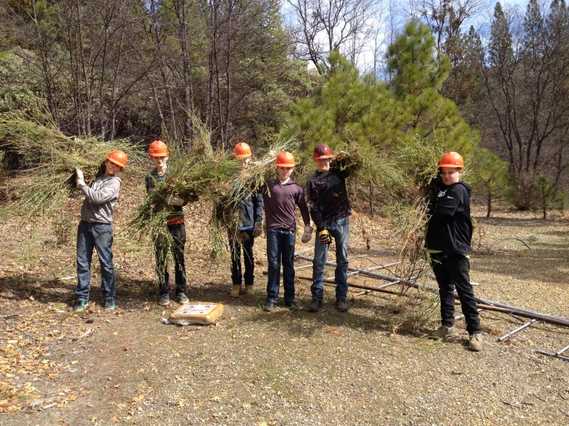
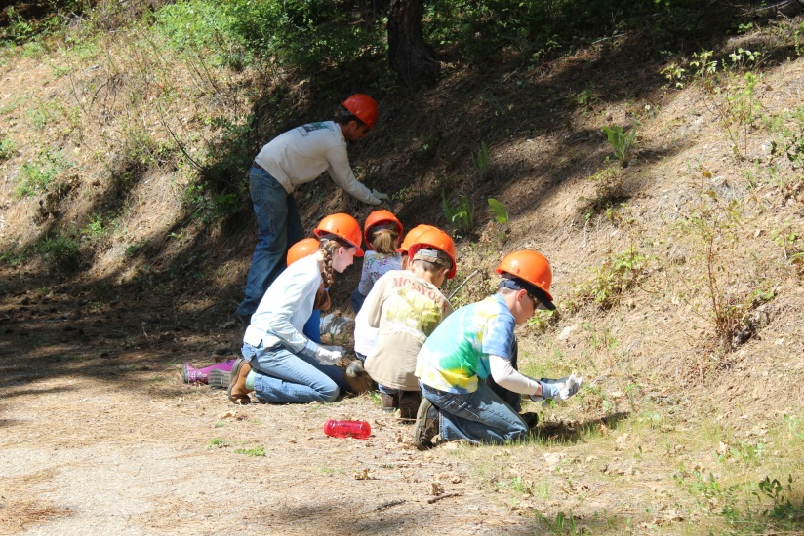
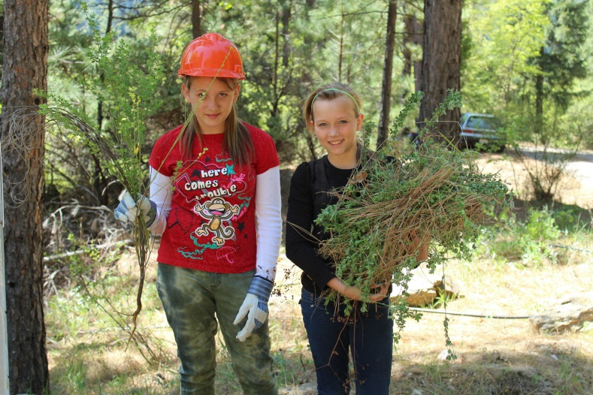
Noxious Weed Control
Notes:
Noxious weed busting has become a popular activity for middle-school aged students in a race of who can pull the biggest weed. Who thought pulling weeds could be so much fun!

Slide 17
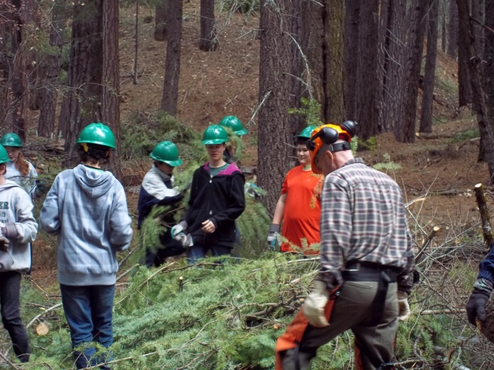
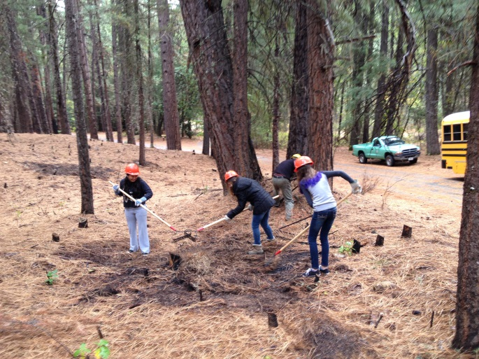
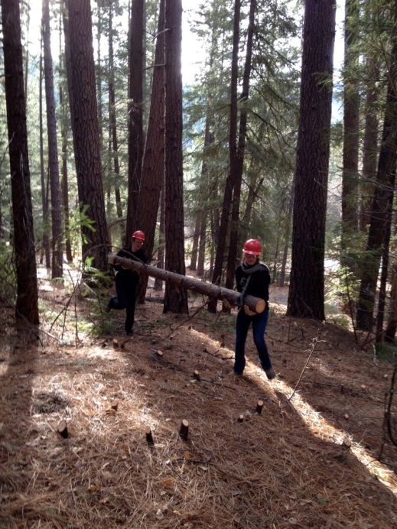
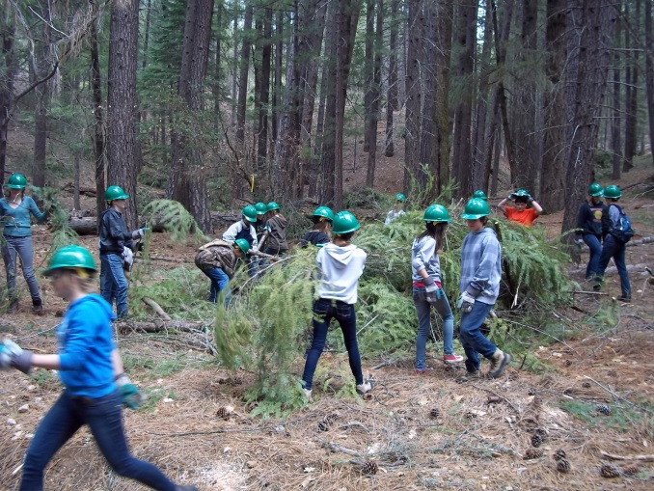
Fuels Reduction
Notes:
Students learn about the importance of fuels reduction and how they can help protect their local communities in the wildland urban interface. They learn the importance and role that fire plays in maintaining forest health. They learn about which trees can be thinned versus larger diameter trees that might be suitable for wildlife habitat. And as our fire ecologist says, they’re learning to “save the world from fiery doom!”

Slide 18
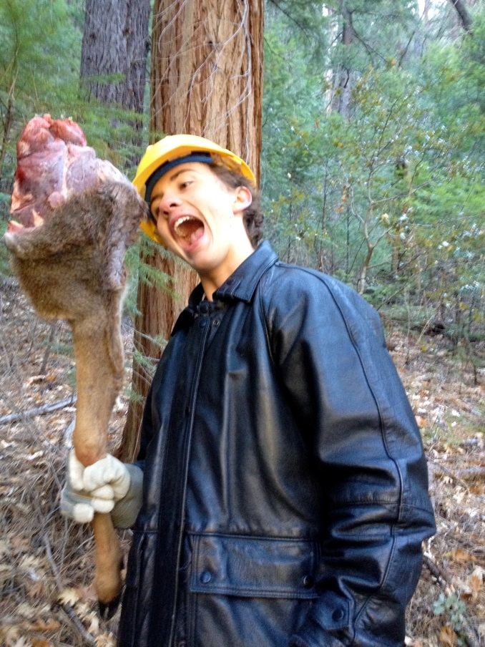
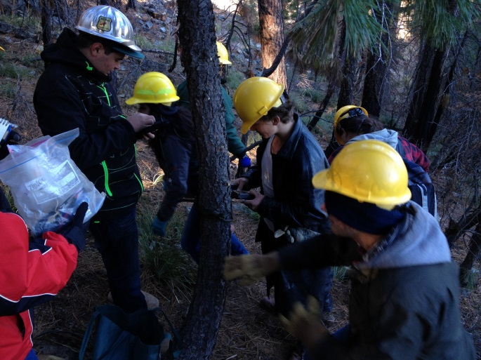
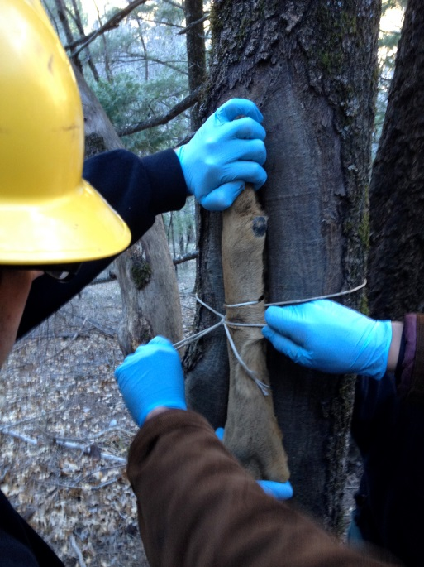
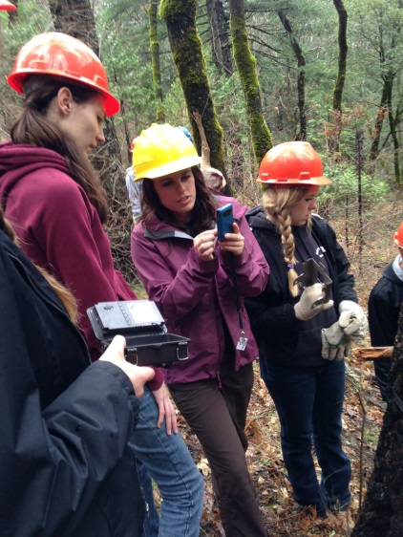
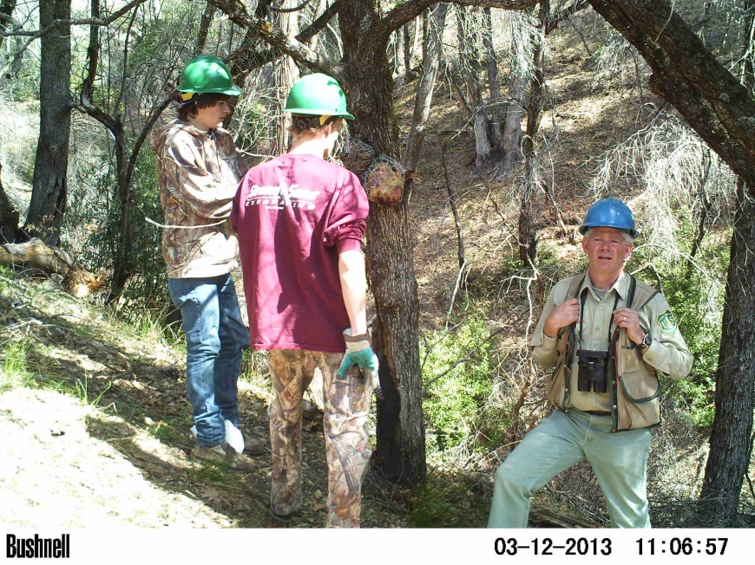
Wildlife Surveys
Notes:
Participation in carnivore surveys is quite popular with high school students as they learn about canopy cover, target species, preparing bait, setting camera stations, and monitoring for results. They also help prepare the wildlife monitoring reports.

Slide 19
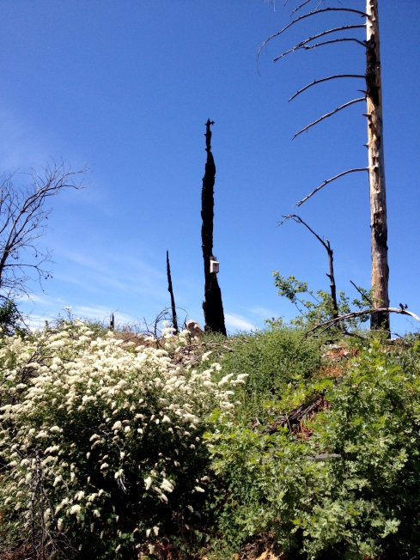

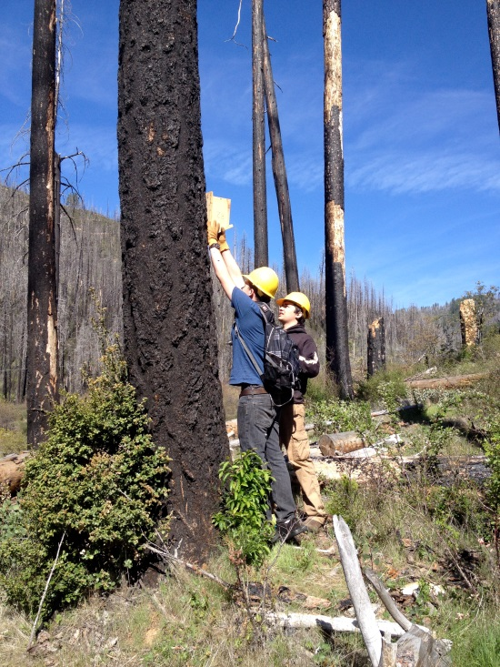
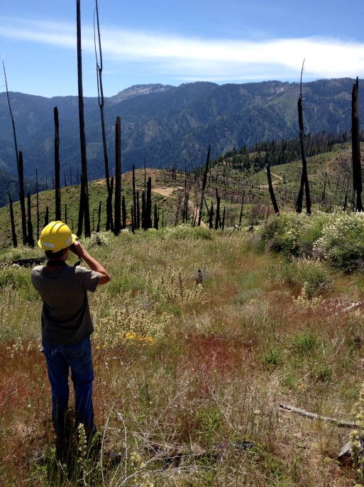
Wildlife Habitat Restoration
Notes:
Songbird nesting boxes are build by the construction technology classes at Chester and Greenville High Schools. Then they’re set out in suitable habitat; students return to monitor for species.

Slide 20


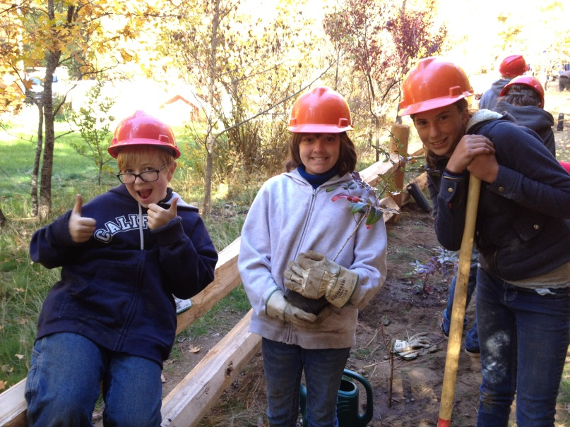
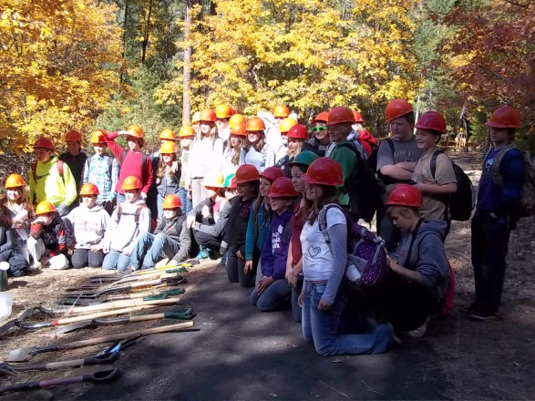
Planting Natives
Notes:
Even middle-school students still enjoy getting their hands in the dirt (gloved, of course). They planted about 100 native species at Hallsted Campground (Dogwood,

Slide 21
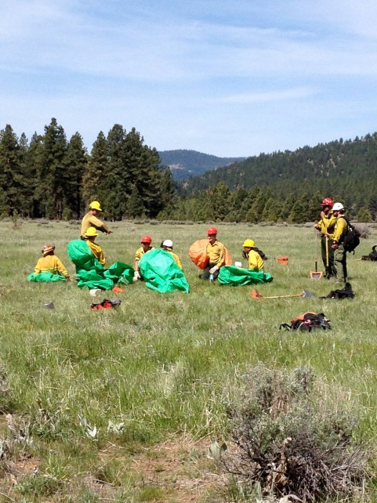
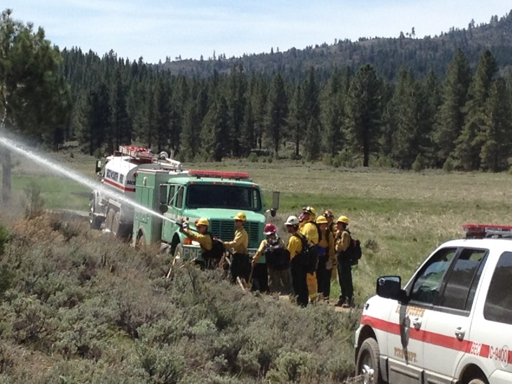
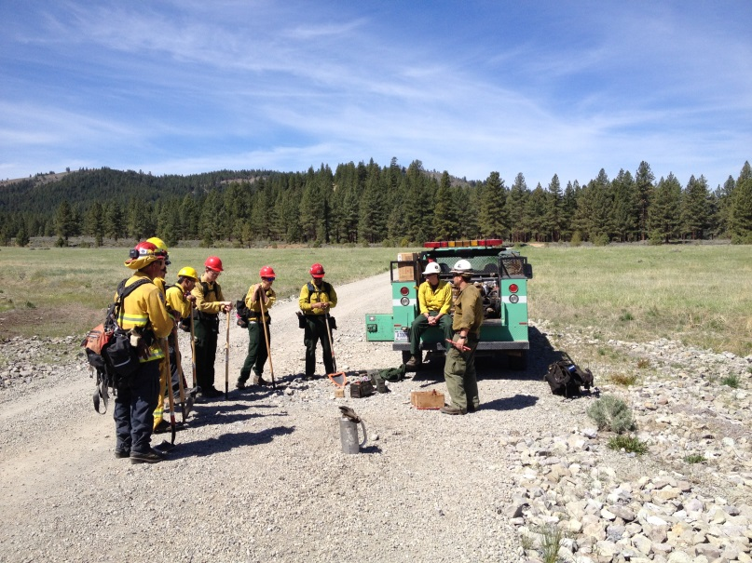
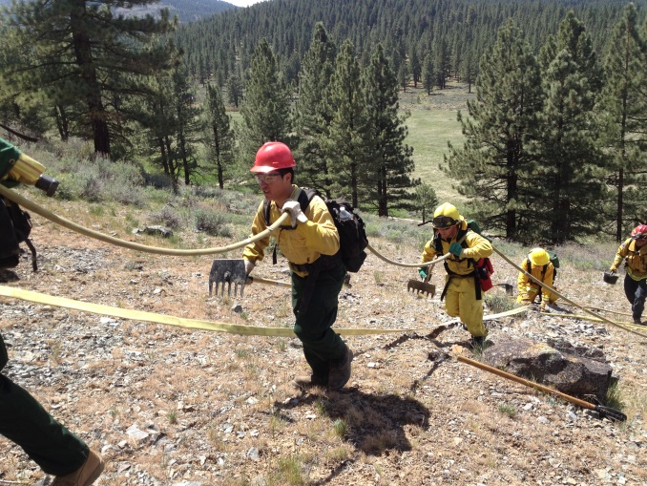
Fire Science – Basic 32
Notes:
One class in particular is greatly inspiring students, fire science out of Portola High School. In late winter, students then take Basic 32 wildland firefighting, participate in a field exercise along with Beckwourth RD and Beckwourth FD. The simulation tests their knowledge and skills and they even deploy training shelters. We are most grateful to the Beckwourth Ranger District for their continued support. (share comment about students inspired to stay in school)

Slide 22
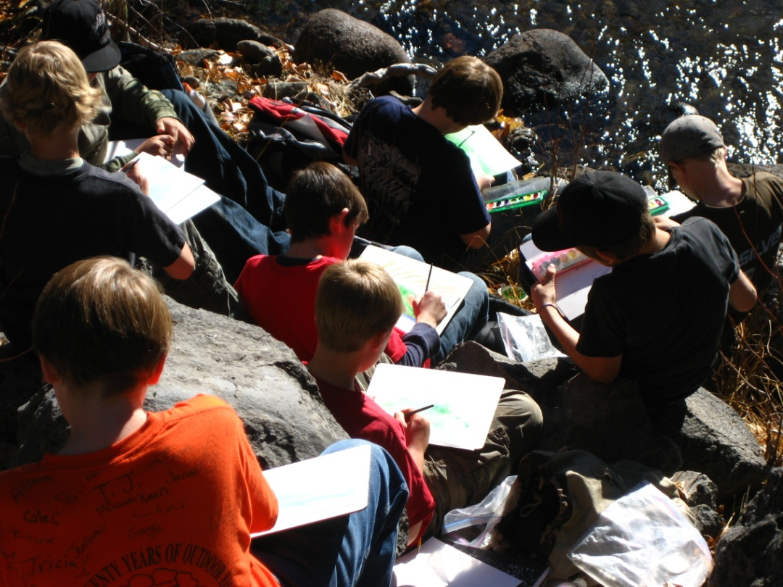
Community
Student sharing about experience
Development of interpretive products: wayside exhibits & Quests
Notes:
Students will share their experience through websites, interpretive exhibits and signs, podcasts, webcasts, and senior projects.

Slide 23
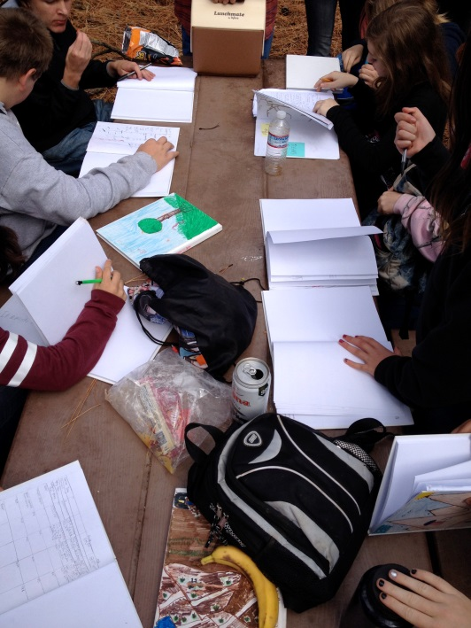
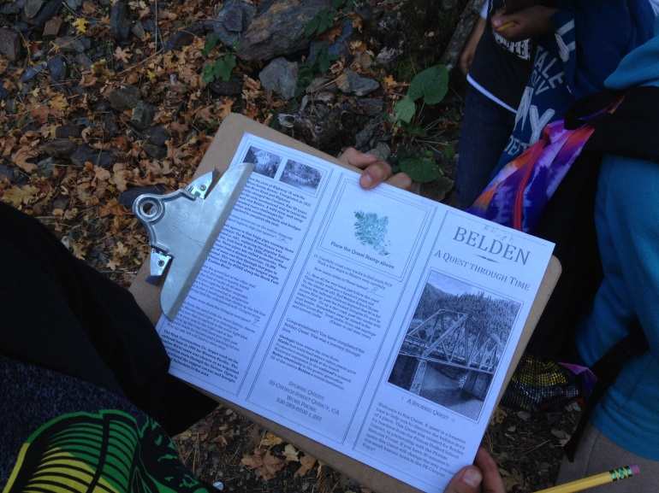
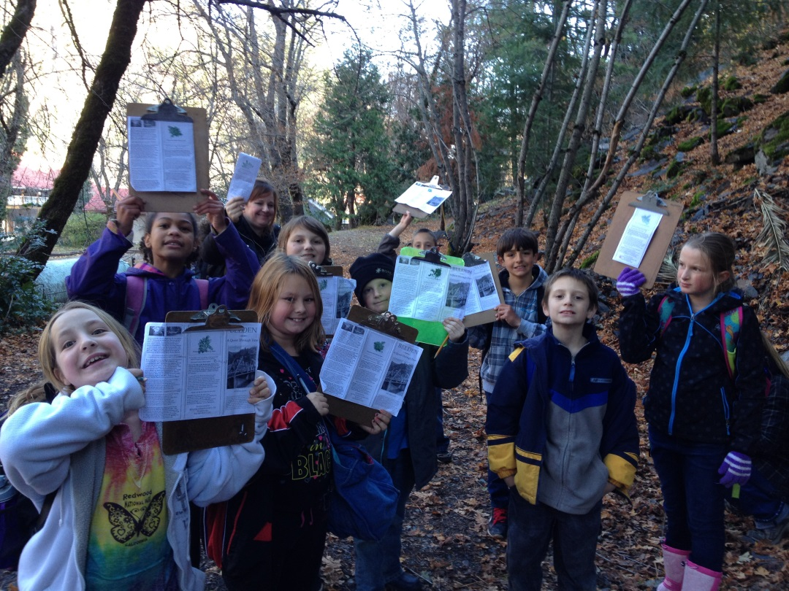

Quests
Notes:
Quests are outdoor treasure hunts specifically geared to 4th-5th grade students. The Belden Quest focuses on canyon history; it is available at Belden Town Resort and on the PNF website. Quests are something for the entire community and for forest visitors to enjoy.

Slide 24
Tangible Outcomes
Model for stewardship and education integration:
Fire-related units for grades 4-12 at all schools – 1,168 students & 1,185 hours of classroom instruction
Regular stewardship field trips: 940 students (2014)
Vocational training and employment
Notes:
Our model integrates education and stewardship. Our students have the opportunity for stewardship field trips, vocational training

Slide 25
Tangible Outcomes
Model for stewardship and education integration:
23 senior projects related to natural resources
Ecosystem restoration: 16,066 volunteer hrs.
Resource monitoring
Public learning about fire-adapted ecosystems
Teacher professional development: FireWorks & Nature Journaling
Notes:
develop senior projects, participation in restoration projects and monitoring, contribute to public learning, and opportunities for teacher career development

Slide 26
Restoration Deliverables
3,840 acres of carnivore monitoring
188 acres of songbird nesting habitat improvement
300 acres of Spotted owl PAC fuels reduction
300 acres Spotted owl & Wood duck nesting boxes
2 acres of fuels reduction/aspen release in Northern goshawk & Bald eagle habitat (30 acre stand)
Notes:
Our student deliverables also help us meet our forest service targets

Slide 27
Restoration Deliverables (continued)
3 miles of trail maintenance
15 acres of endemic planting: Webber’s milkvetch
3 acres of campground improvement
1 acre of native planting (campground)
5 acres of fuels reduction (WUI – Twain)
6 acres of mixed conifer seedling planting
Notes:
Our student deliverables also help us meet our forest service targets

Slide 28


Restoration Deliverables (continued)
Sierra Nevada FireWorks curriculum
Notes:
Our student deliverables also help us meet our forest service targets

Slide 29






Teacher workshops
Notes:
Teacher workshops provide an opportunity for in-depth learning from our resource specialists and learn how to apply academic learning in the classroom to the outdoors.

Slide 30
Intangible Outcomes
Enhance quality of education for students
Strengthen local public institutions
Create a model for educational partnerships
Engage the community in hands-on restoration
Increase appreciation for public land
More kids out in the woods!
Notes:
Some of the intangibles include enhanced education, a model for partnerships, community involvement, appreciation for our public lands, and more kids out in the woods!

Slide 31






Notes:
These are the faces of stewardship

Slide 32

Tomorrow’s Leaders
Notes:
That grow up to become tomorrow’s leaders. (Rob shares what our future looks like)

